Slide 1
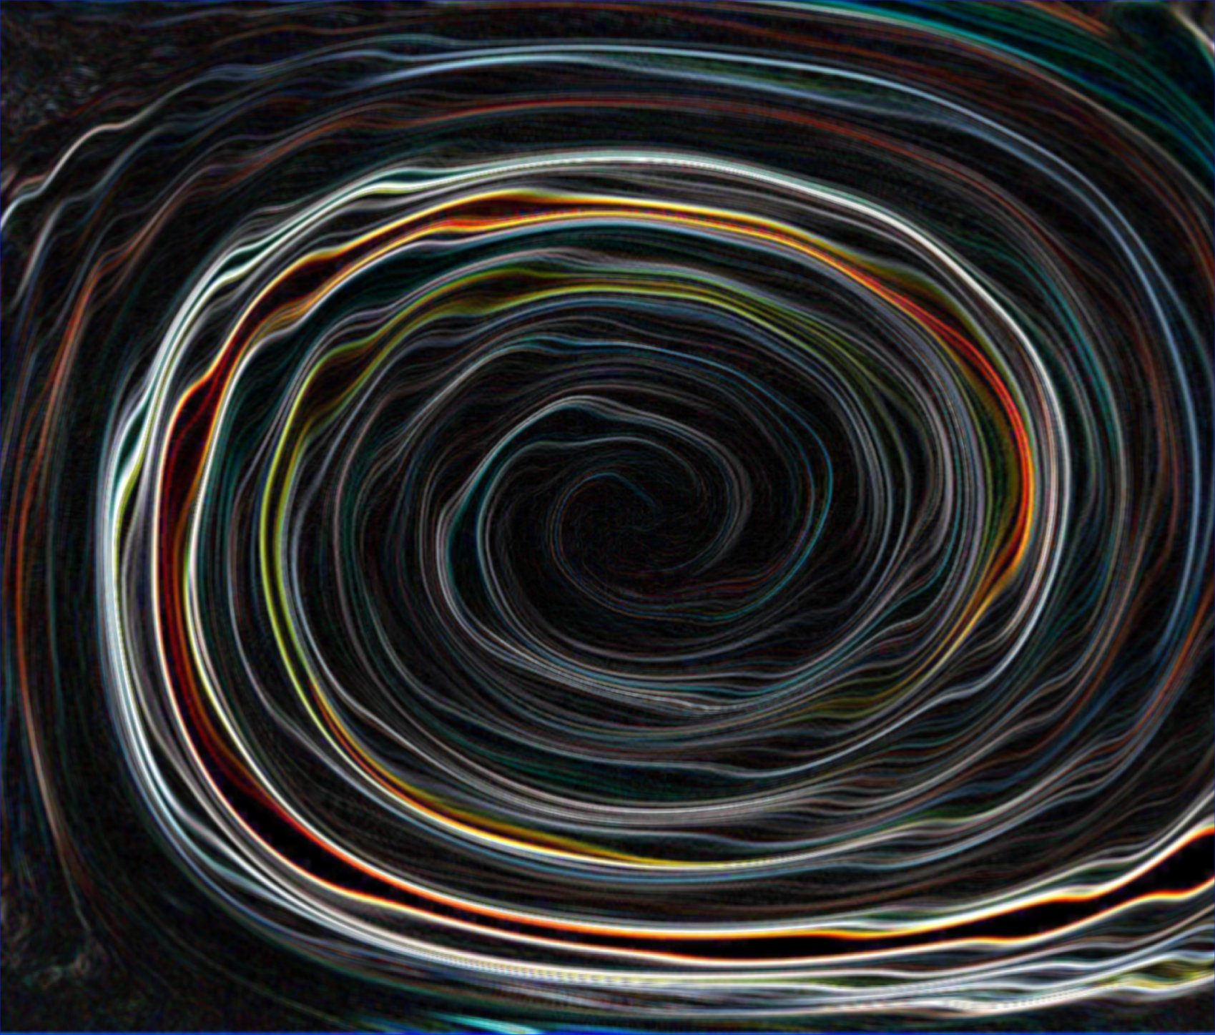
Time Travel

Slide 2
Outline
The Quantum Physics of Time Travel
Time Travel in Literature
Time Travel in Movies
Time Travel in TV and Popular Media
The 100 Years of Solitude

Slide 3
The Quantum Physics of Time Travel

Slide 4
The Grandfather Paradox
Our friend Sonia travels back in time and meets her grandparents
The paradox:
How can Sonia be sitting here telling us about her adventure if her grandparents never got together?
When she returns to 1934, can she bring her grandparents’ romance to a premature end?

Slide 5
The Grandfather Paradox
If Sonia can prevent her own birth, there is a contradiction
If she cannot, that inability conflicts with common sense, for what would prevent Sonia from behaving as she pleases?

Slide 6
The Painter and the Critic
An art critic from the future visits a 20th century painter
Reproductions exist because they’re copied from the paintings, and the paintings exist because they’re copied from the reproductions

Slide 7
Relativity
Physicists traditionally invoke a chronology principle that rules out travel to the past– travel to the future is fine
Einstein’s theory of relativity and aging
Four dimensional space time
Your life forms a four-dimensional “worm” or “worldline” in space-time
A flash of light spreading out in all four direction forms a cone in space time– a “lightcone”

Slide 8
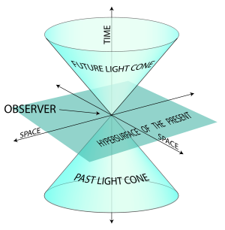
Lightcone

Slide 9
Terms
Closed timelike curve: space time gets so distorted it forms a closed loop
Autonomy principle: it is possible to create in our immediate environment any configuration of matter that the laws of physics permit locally
Consistency principle: the only configurations of matter that can occur locally are those that are self-consistent globally
Ex. Grandfather paradox
Knowledge paradox: knowledge can only come into existence as a result of problem-solving processes
Ex. Art Critic

Slide 10
Quantum Mechanics
Stephen Hawking argues that quantum mechanical effects would either prevent CTCs from forming or would destroy any would-be time traveler approaching one
But we could maybe find them at submicroscopic scales
Quantum mechanics predicts all possible outcomes of an observation and the probability of each
If something can happen, it does in some universe– “multiverse”

Slide 12
Time Travel in Literature

Slide 13
Traveling to the Future
More Widely represented by literature.
Attempt to preserve the death of famous literary figures (i.e. stopping Hemingway’s suicide in the Kilimanjaro Device).
Transporting Thomas Wolfe out of his death bed in 1938 for last long writing assignment (in Forever the Earth).
Recognizes that literary and artistic genius are not reproducible. Acknowledging the difficulties mass time traveling would pose to society, focuses on targeting specific individuals who can make a difference (that would not dramatically alter our own disposition or being).

Slide 14
Traveling Back in Time
Grandfather Paradox. More modern idea.
Of Time and Third Avenue (Bester), Mimsy Were the Borogoves (Padgett), Something for Nothing (Skeckley) all introduces time traveler from the future.
Contains wary message : unearned gifts generally bring grief and greater loss.
Analogy of the Three Wishes
Final wish undoing the unforseen consequences of the first two is the precursor to all modern change the past stories

Slide 15
Experiencing Time Traveling in the Present (1/2)
Episodic memory implies a mental reconstruction of some earlier event, including at least some of the particularities of that event, such as the principal characters involved, the actions that took place, the setting, and the emotional reactions.
The idea could be readily extended into the future.
Generative process, incorporating known elements but arranged in particular ways to create the experience of events that are actually occurring.

Slide 16
Experiencing Time Traveling in the Present (2/2)
Time traveling by dreaming (i.e. Wells’ “The Dream”, Bellamy’s “Looking Backward”)
Element of suspense and intrigue without the complications that time travel might pose on our own existence.
Sleeping to get characters to the future becomes widely used (i.e. The Year 2440)
Instead of time traveling, wants to create someone who is “Out of Time.” Threatening -> Victim.

Slide 17
Time Travel in Film

Slide 18
Play Tova’s movie clips

Slide 19
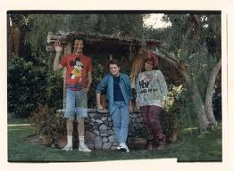
Movies and the Grandfather Paradox
Back to the Future
Marty and his siblings begin to disappear when his parents fail to kiss at the Enchanted Under the Sea Dance
Kate and Leopold
Kate is Stuart’s great-great-grandmother in an extended version of the film
Hot Tub Time Machine
Jacob begins to flicker out of existence when his biological father fails to have sex with his mother
Notes:
-As we already know, the Grandfather paradox is the idea that if we travel back in time, we can accidentally erase our own existences. This comes up a lot with time travel in film. In Back to the Future, it’s tracked by a phorograph that Marty periodically refers to. The longer Marty’s parents take to get together, the more he and his siblings disappear, both from the photograph and in real time.
-In Hot Tub Time Machine there is a similar concern. The youngest member of the group, Jacob, begins to flicker, as if about to disappear, when his biological father puts off a one night stand he had had with Jacob’s mother in 1986.
-In Kate and Leopold, the Grandfather paradox is a bit different. Kate’s ex boyfriend is Stuart. Stuart is the man who initially figures out how to travel back and forth in time. When Kate ends the movie by deciding to stay with leopold in 1876, the audience realizes that Kate is in fact Stuart’s great great grandmother, a bizarre, incestuous reference to the grandfather paradox.

Slide 20
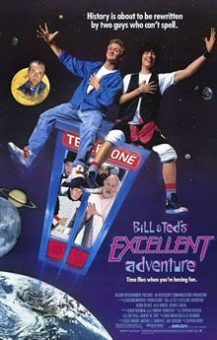
Why Time Travel?
Chooses to Time Travel:
Stuart and Kate, Kate and Leopold
Bill and Ted, Bill & Ted’s Excellent Adventure
Austin Powers, Austin Powers The Spy Who Shagged Me
Accidentally Time Travels
Marty McFly, Back to the Future
Phil Connors, Groundhog Day
Guys From Hot Tub Time Machine
Leopold, Kate and Leopold
Notes:
-So why time travel? In many movies, the premise is that the protagonist somehow ends up traveling through time, rather than pursuing it. This is the case in Hot Tub Time Machine and Groundhog Day. Although initially unintentional, the characters are able to capitalize on their situation. Phil is able to try different scenarios until he is able to win over the Andie MacDowell character. In Hot Tub Time Machine, the men initially try to remake their past exactly so as not to ruin the future but soon realize that they may be able to change their destinies for the better. Marty McFly is also able to capitalize on his accidental situation. He is able to change the course of his parents future, making the family as a whole more successful.
-In those films where the protagonist chooses to travel through time there are a number of motivations. For Kate in Kate and Leopold, it was love. For Austin Powers, it was to defeat Dr. Evil. For Bill and Ted, it was to pass high school. However, often times, there are consequences

Slide 21
Consequences
Insanity
Stuart in Kate and Leopold is sent to an asylum
Phil Connors in Groundhog Day believes himself to be a god, people think he is crazy
Incest
Kate inadvertently has a romantic relationship with a distant ancestor, Stuart.

Slide 22
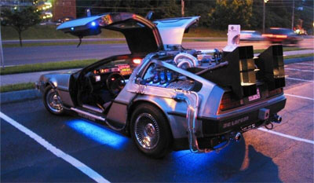
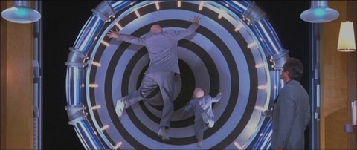
Time Travel Vehicle
Phone Booth: Bill & Ted’s Excellent Adventure
Hot Tub: Hot Tub Time Machine
DeLorean: Back to the Future
Swirling Vortex: Austin Powers

Slide 23
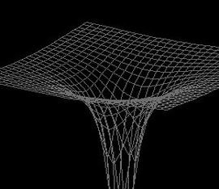
Rift in the Space Time Continuum
Groundhog Day
Kate and Leopold

Slide 24
Time Travel in Mainstream Media

Slide 25
Play Leah’s TV show clips

Slide 26
Various TV Shows
Dr. Who
The Simpsons
Futurama
Lost
Quantum Leap
Star Trek
And many many more…
Notes:
They’re all over the place. Some are specifically about time travel, but some just mention it for an episode or two. Shows the embedded nature of time travel in society’s psyche.

Slide 27
Lessons Learned From TV Time Travel…
Don’t change ANYTHING. Ever.
Change things if you have to….things will be catastrophic if you don’t!
Don’t talk to your past self
You probably know too much and the knowledge is shockingly difficult
Always be careful
It’s weird to meet your past self and you should generally try to avoid it.
The fate of the world and various realities rest on your capable shoulders!

Slide 29
100 Years of Solitude

Slide 30
Time Travel in One Hundred Years of Solitude
Published in 1967 by Gabriel García Márquez

Slide 31
Several Interpretations of Time
The general movement of the history and of the family appears to follow linear progression of events—along an arrow of time marked by genealogical progression.¹
Time as circular movement
Time as relative movement
Qualitative measures of time
Notes:
1. Pastor, Lahr, Beatriz, Dwight. A Matter of Time. 2001. Print, p.390.

Slide 32
Linear Time
Creation: “At that time Macondo was a village of twenty adobe houses, built on the bank of a river of clear water that ran along a bed of polished stones…The world was so recent that many things lacked names, and in order to indicate them it was necessary to point” (p.6).
Similar to Bible in that: “That time” is the time before history, before language, before civilization. Like biblical time after creation, it will move through the generations, tracing the movement along its arrow through the genealogies of the family tree: from Jose Arcadio Buendía, the first of the line, to Aureliano the last of the line. ²
Notes:
2. Pastor, Lahr, Beatriz, Dwight. A Matter of Time. 2001. Print, pp.392-393.

Slide 33
Circular Time
Cyclical Time exists side by side the arrow of time.
Ice example (p.6)
Evident in Ch. 2 in which we find ourselves amidst the town of Riohacha during a 16th century attack by Sir Francis Drake.
The very lives of some of the Buendias are shaped by circular time patters—Jose Arcardio’s sister, Amaranta and her brother Aureliano. ³
Notes:
3. Pastor, Lahr, Beatriz, Dwight. A Matter of Time. 2001. Print, p. 394

Slide 34
Circular Time (Continued)
Pilar Ternera who is the card reader states:
“…the history of the family was a machine with unavoidable repetitions, a turning wheel that would have gone on spilling into eternity…” (p.425).
The family tree stands for linear time. However, the Buendias family tree is unusual. The same names are always passed on from generation to generation. The pattern of name-repetition appears to neutralize time—the genealogy does not imply a progress or development along the arrow of time as in Genesis. Furthermore, it appears that a certain name implies certain qualities in the person or a certain personality.⁴
-For instance, the Jose Arcadios are always extroverted, men of action, whereas the Aurelianos are more introverted and visionary.
-In this sense, the arrow, linear view of time becomes meaningless as a measure of human progression.
-Incest Metaphor
Notes:
4. Pastor, Lahr, Beatriz, Dwight. A Matter of Time. 2001. Print, p.396.

Slide 35
Relative Time
“Many years later, as he faced the firing squad, Colonel Aureliano Buendía was to remember that distant afternoon when his father took him to discover ice” (P.6).
Colonel Aureliano Buendía’s time:
Future=Many years later, Present=as he faced the firing squad, Past=took him to discover ice
Narrator’s time:
Future=the order of discourse, story yet to be told, Present=utterance of discourse, Past=time of events being narrated, when things happened (includes Buendía’s future, present, and past).
Reader’s time:
Future=all that remains to be read, Present=the act of reading, Past=all that has been read
These two lines highlight the relative unstable, shifting nature of time. Time is relativistic in relation to the position of an observer: character, narrator, reader.⁵
Notes:
5. Pastor, Lahr, Beatriz, Dwight. A Matter of Time. 2001. Print, p.392.

Slide 36
Qualitative Measures of Time
There is also a time of decay; a meaningless, unproductive, undifferentiated time:
“he had seen them as he passed by, sitting in their parlors with an absorbed look and folded arms, feeling unbroken time pass, relentless time, because it was useless to divide it into months and years, and the days into hours, when one could do nothing but contemplate the rain” (p.208).
Qualitative measures of time—like decay and (growth)—seem to overlap with the arrow and the circle as the main models of time reckoning and perception.⁶
They add a particular dimension to them (think of linear arrow and circle as 2d, spiral as 3-d, these seem to add the fourth dimension).
Notes:
6. Pastor, Lahr, Beatriz, Dwight. A Matter of Time. 2001. Print, p.396.

Slide 37
Time Travel
The cyclical patter of time lends a new dimension to the arrow of history. It is connected to a back and forth movement—from past to future and from future to past—through the arrow of time. Science and science fiction call this movement time travel.⁷
Using different narrative techniques such as third-person narrators, specific point of view narrators, and streams of consciousness, Márquez is able to create an experience of time travel.
For instance, Jose Arcadio connects the pendulum mechanism of a lock to a mechanical ballerina. This causes the ballerina to dance to the rhythm of her own music for three days without interruption. This causes Arcadio’s biological clock to break down:
He stopped eating. He stopped sleeping. Only the vigilance and care of Rebeca kept him from being dragged off by his imagination into a state of perpetual delirium from which he would never recover” (p.84).
Notes:
7. Pastor, Lahr, Beatriz, Dwight. A Matter of Time. 2001. Print, p.48.

Slide 38
Time Travel
He begins to slip away into this delirium in which he discovers that space and time are not what we think them to be. For instance, he walks into Aureliano’s workshop and asks, “What day is it today?” Aureliano tells him that it is Tuesday. “I was thinking the same thing, replies Arcadio, “but suddenly I realized that it’s still Monday, like yesterday. Look at the sky, look at the walls…Today is Monday too” (p.85). The following day he again concludes that it is still Monday. The next day, he walks into the workshop sobbing: “The time machine (his clock mechanism) has broken” and he proceeds to go mad.
He realizes that the concept of absolute time does not correspond to natural processes and changes—the world told him that everything was the same so how could it be Tuesday when everything he said told him it was the same as Monday—he had effectively stopped time or was continually traveling to the past. Yet, neither nature’s rhythms, nor human perceptions can be fully accounted for by the time machine (clock and calendar).⁸
Notes:
8. Pastor, Lahr, Beatriz, Dwight. A Matter of Time. 2001. Print, pp. 397-398.

Slide 39
Time Travel (Melquídes)
Melquíades, the gypsy, is a time traveler. He is the only one who defeats time: he becomes immortal. Time travel becomes plausible when time is not linear.
“…Melquíades had not put the events in the order of man’s conventional time, but had concentrated a century of daily episodes in such a way that they coexisted in one instant” (p.446).
Melquídes’ time code represents an alternative to “man’s conventional time”, that is to the view of time that Jose Arcadio rejects when he steps into a madness that turns out to be a higher wisdom. Only by leaving the “conventional time” behind and steeping into the time symbolically inscribed in Melquíades’ code, can we take the leap that will reveal a new wisdom, in a vision of reality that was hidden by the time habits of succession and predictability.⁹
Notes:
9. Pastor, Lahr, Beatriz, Dwight. A Matter of Time. 2001. Print, pp. 399-400

Slide 40
Questions
In what ways do various media forms portray quantum physics?
How do notions of time travel (and the lessons of time travel) relate to understandings of time we have studied so far? For example, Aristotle? Descartes?
What are some major themes across the board in time travel literature, television, and movies?
Why do you think there is such a cultural obsession with time travel?
What would you travel back in time to do?

