Slide 1
Mind Time and Body Time:
Poe, Freud's Wolf Man, and Aveni's Empires of Time
Tramon McZeal, Kristina Williams, Stephanie Hernandez, Stephen Greene, Alice Lloyd, Sutton Lowry

Slide 2
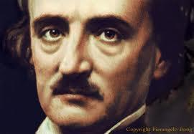
Part I: Edgar Allan Poe
Poe was born on January 19, 1809 in Boston Massachusetts.
He is considered to be part of the American Romance Movement.
Eureka was his career masterpiece.

Slide 3
Summary of "The Bells"
Silver Bells Brazen Bells
"World of Merriment" "Tale of Terror"
"Tinkle" "Scream"
Golden Bells Iron Bells
"World of happiness" "World of Solemn"
"Ring" "Shiver"

Slide 4
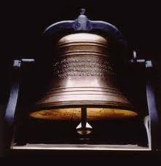
"The Bells" by Edgar Allan Poe
Representation of Time
Progression of mentality and mental maturity
Progression of day to night
Progression of age
Progression of romance

Slide 5
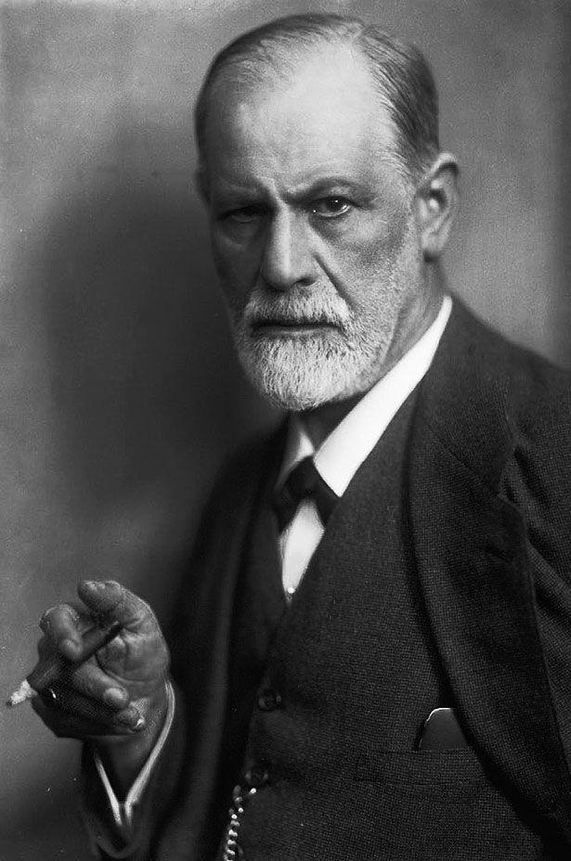
Part II:
Freud's Wolf-Man

Slide 6
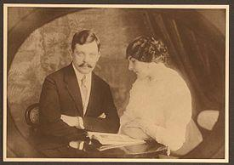
Freud's Wolf-Man
Serfei Pankeieff (“Wolf-Man”)
Suffered from Neurosis
Mental disorder of sense and motion
The chronology of neurosis: not organized by usual time measurement but by associations of a series of time-related disturbances
Came to Freud in February 1910
Had several traumatic events throughout his life
Wolf-Man's Sense of Time (Time Blocks)

Slide 7
The Process of Analysis
Patient Talks, Analyst Listens, Analyst Gives Comments
Allows memories to (re)surface
The patient and the analyst try to make connections and associations with the events/dreams/memories
Solution: together they create a narrative of the patient’s life

Slide 8
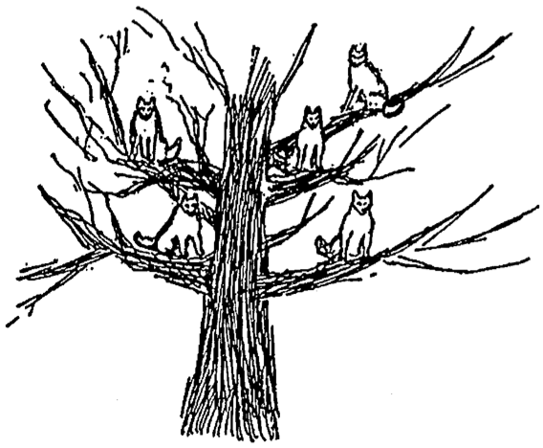
The Dream

Slide 9
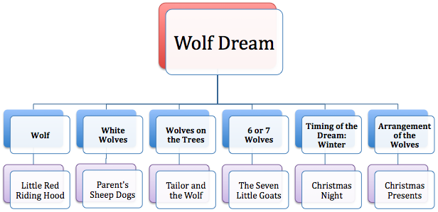
The Wolf Dream and Life Associations

Slide 10
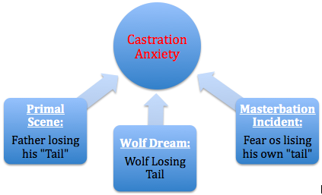
The Wolf Dream and the Primal Scene
Primal Scene
Castration Anxiety:
Transferring his emotional trauma from the past to the present
Viewed his life by associating current events with past events
Had to rewire his brain to associate events with chronological time/order

Slide 11
Mind Time and Body Time
St. Augustine: His analysis of Time as presented in his treatise, The Confessions: Book XI, Time and Eternity
"What about those two times, past and future: in what sense do they have real being, if the past no longer exists and the future does not exist yet? As for the present time, if that were always present and never slipped away into the past, it would not be time at all; it will be eternity."
These are three realities in the mind, but nowhere else as far as I can see, for the present of past things is memory, the present of present things is attention, and the present of future things is expectation. If we are allowed to put it that way, I do see three tenses or times, and admit that they are three."
What does this mean??
The present is a fleeting attention; our acquaintance with the past is through present recollection of it; and our acquaintance with the future is through expectation.

Slide 12
The Wolf Man Himself
Body Time:
Twenty-three year old Russian Aristocrat
Refined Millionaire with personal attendants and private physician
Should be...
So why does he need Freud?
Mind Time: Stuck in Infantile State
Lack of response to outside stimuli
Total helplessness and dependency
Failure of Basic Bodily Functions i.e spontaneous bowel movements
General inability to deal with others and carry out normal lie

Slide 13
Psychosexual Analysis and Time
Sigmund Freud developed a theory of how our sexuality starts from a very young ages and develops through various fixations. If these stages are not psychologically completed and released, we can be trapped by them and they may lead to various defense mechanisms to avoid the anxiety produced from the conflict in and leaving of the stage.
Oral stage 0-18 Months Weaning away from mother's breast
Anal Stage 18 Months to 3-4 years Toilet training
Phallic 3-4 years to 6-7 years Oedipus (boys),
Electra (girls)
Latent Stage 5-7 years to puberty
Genital Stage Puberty on Social rules

Slide 14
Time in the Process of Psycho Analysis
Time and the Patient:
Time is a mental construct, which within the individual is manipulated based on coding
Often Primal: coded in terms of basic emotions, fear, anxiety, stress, happiness
Historical Chronology
Time and Freud: Kronos?
Time Control: Duration and Frequency
Free Association:
Timeless
Uncovers past, creates link to present fixations and uncovers the past constructs that are blocking time and inhibiting maturity of the mind
Provides proper coding: Language

Slide 15
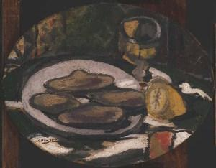
Part III Aveni: Introduction & Ch. 1
Lemons and Oysters, Georges Braque, The Philips Collection,
Washington, D.C.

Slide 16
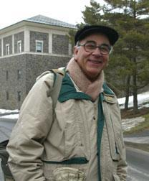
Introduction
“We've got rhythm!” -Anthony F. Aveni
The music of one’s life
The reversible recurrence of time

Slide 17
Introduction
Cultural
Knowledge is determined by culture: “…the way a people perceive [time] can only be revealed by studying, in detail, the way they reckon its passage—that is, the phenomena they see, the units they define to relate events to one another, and, most important of all, the images and metaphors they use to conceptualize time.”
Absolutist
All human knowledge is absolute in nature, separate from culture: “…all human beings think of time as duration and of duration as either cyclic or linear. …the cyclic is static (in the sense that all things return to the same point in time) and associated with ritual behavior, while linear time is dynamic and has more to do with practical behavior. ”

Slide 18
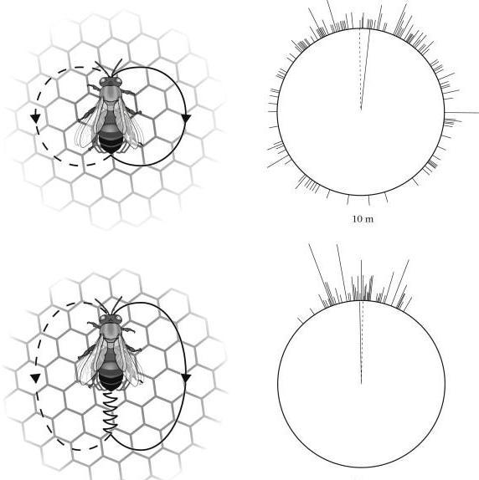
Ch. 1: Oysters, Potatoes, Bees and Mice & Circadian Rhythms
“If bees know when to turn up at a feeding place, they must possess some sense of time.”
“Is a sense of time built into all organisms, or are we really being driven by the earth clock outside us?”

Slide 19
Ch. 1: The Internal Timer Hypothesis vs. The Exogenous Hypothesis of Time Sensing
Q: How is the connection between life cycles and celestial rhythm established?
A: μεν “…because these rhythms persist when the organism is deprived of functioning within the natural environment, every piece of living matter must be its own timer.”
δε “Organisms oscillate with natural geophysical frequencies because they respond directly to changes in the forces of an all-pervasive environment. …[Isolated] organisms have a subtle ways of sensing what is really happening in the world outside.”

Slide 20
Ch. 1: Humans’ Inner Rhythms + Grunion, Hamsters
Sleep-wake Rhythms
Menstruation, from menses or month (a contraction of moon-th)
Grunion:
“These moon-
based cycles may be
a reflection of our
original ascent from
the sea.” Aveni, p. 420
Exogenous vs. Endogenous (Hamster testes! Coral!)

Slide 21
Ch. 1: Man as Machine, Machine as Metaphor
“…the language used to describe the way we in the West think the coupled circadian oscillation works consists of neural networks, transducers, pacemakers, command posts, control mechanisms, cues, signals, oscillators—that familiar language of information retrieval and processing in which the twentieth century is embedded. At least since the Industrial Revolution, if not from the Renaissance, when we first began to manipulate and experiment with nature, we have come to have faith in the machine, to believe in mechanism as a way of understanding.”

Slide 22
Part IV: A World of Time
Building on Basic Rhythms
Time begins as human consciousness
Communication allows us to conceptualize others' interpretation of time
This communication resulted as a result of numerically quantifying time>signifier represents real thing in universe, tangible (recognition of patterns)

Slide 23
Part IV (Cont.)
Recurring Cycles
Nature broadcasts in decidedly cyclical nature, only natural that we internalize pattern
Other models of representing time
Modern interpretation of time has made human beings nonparticipants, negative consequences (St. Augustine)
Our conceptualization of time is purposeless

Slide 24
Part IV (cont.)
Linearization of Time
As Westerners we are caught in an everlasting string of nows, constantly working for destination
Obsession with linear time stands in stark contrast to Trobriand gardeners, language possesses no tenses
We assign value laden words to other cultures->superstition

Slide 25
Part IV (cont.)
Controlling the Rhythms
Rigid control of time->making money in highly industrialized, technological world
Only the ruling class can introduce new festivities->must cultivate roots of past

Slide 26
Part IV (cont.)
Controlling the Rhythm (cont.)
Time captivates not as a pure fact of nature but instead as dimension of life that can be controlled
We grabbed ahold of time and sought to manipulate it
We were once harmonized with nature—have dehumanized time

Slide 27
Questions
Edgar Allan Poe:
Why do you think the author uses bells to represent the progression of time/human life?
Bells were more prevalent in Poe's time. What do you think would be akin to the bells in todays world?
Freud's Wolf-Man:
In order to cure Wolf-Man's neurosis, Freud had to recover and reorganize Wolf-Man's life events. How did Freud cure Wolf-Man's neurosis (the process)? Do you think Wolf-Man's change of understanding time changed his sense of self or his individual perception of reality?
What is your perspective on the psycho analytical process. Is Freud uncovering a lost timeline of repressed memories, or is her merely recreating a new time line in order to explain his patients dirorders?

Slide 28
Questions (cont.)
Aveni's Empires of Time : (Intro and Ch. 1)
1) Do you personally view time as a culturalist or as an absolutist? Has your view changed since the beginning of the term? If so, how?
2) Exogenous (external timer) or endogenous (internal timer)? Humans? Animals? Draw on course readings/discussion to support your answer!
3) What do you make of the definition “the idea that an ordered sequence can be recognized in our states of consciousness”? Would you include it in your paper for Monday?

