Slide 1
JPEG Image Compression
Matt Marcus

Slide 2
JPEG
Lossy compression
Discards high frequencies
Works on best images with smooth transitions

Slide 3
Algorithm
Image is represented by Y’CBCR (Y’=luma component for brightness, CB,CR=chroma components for color)
Split image into 8x8 blocks
Perform DCT on each block
Quantize the frequency components of the DCT
Compute inverse DCT to get compressed image

Slide 4
Wallace, 1991

Slide 5
Discrete Cosine Transform (DCT)
Relationship to DFT
DCT is

Slide 6
Quantization
Humans can’t see really high frequencies
Able to discard without perceptible differences
Quantization accentuates the greatest values from DCT in upper-left corner

Slide 7
Optimal Patch Size
Why 8x8 over smaller (4x4) or larger (16x16, 32x32)?
Experiments showed few gains for larger sizes
Larger —> more high frequency components, bigger jumps at boundaries
Smaller blocks are harder to compress

Slide 8
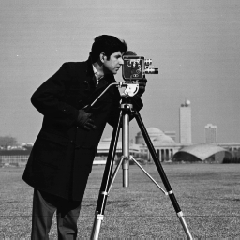
Comparing results
Matrix | L2-Norm | NxN Dimensions | Output Size (KB) | xSmaller | DCT Time (sec)
 | 13.72 | 8x8 | 57.8 | 1.101 | 0.0456
 | 2102.1 | 8x8 | 17.7 | 3.601 | 0.0397
 | 20.59 | 16x16 | 52.0 | 1.223 | 0.0136
 | 13.65 | 16x16 | 58.4 | 1.090 | 0.0152
First row has 16 1s, second has 15 1s, until 16th row has one 1 | 13.60 | 32x32 | 60.0 | 1.06 | 0.0136
 | 13.75 | 4x4 | 57.7 | 1.10 | 0.0139

Slide 9
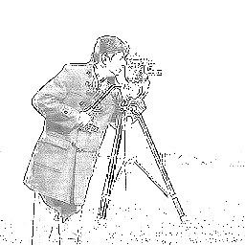
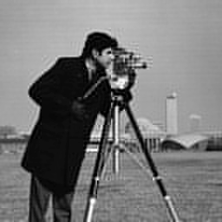
First row has 16 1s, second has 15 1s, until 16th row has one 1

Slide 10
Image Quality
Scale from 1-100%
Most of the time, between 50-100%

Slide 11
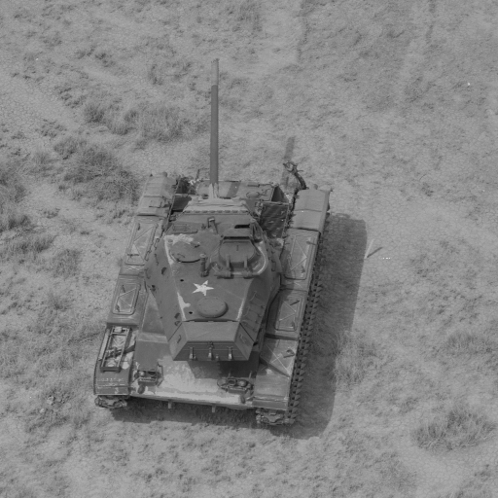
More experimental results

Slide 12
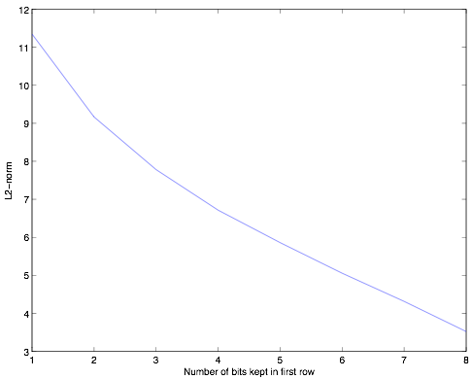

Slide 13
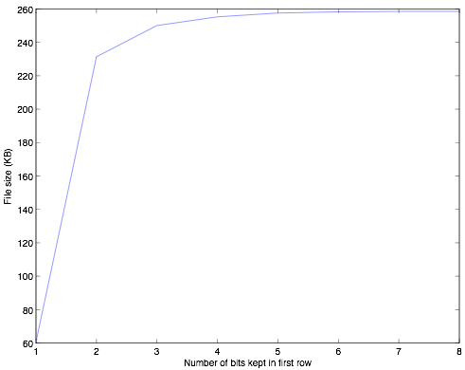

Slide 14
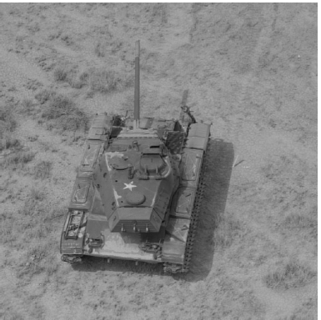

Slide 16
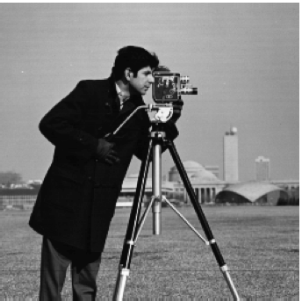
Reducing all frequencies

Slide 17
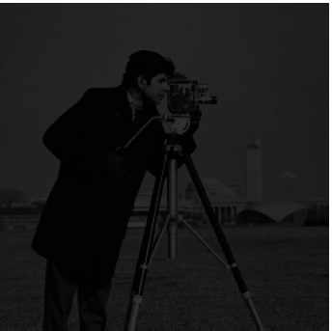
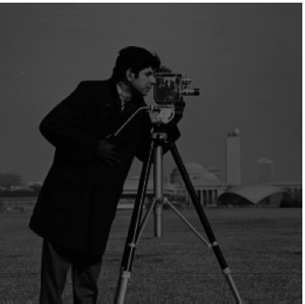
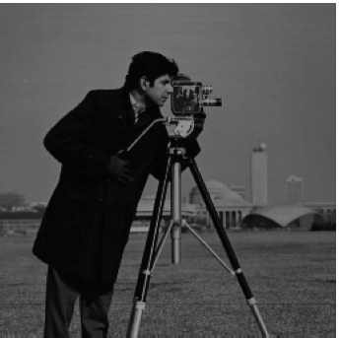
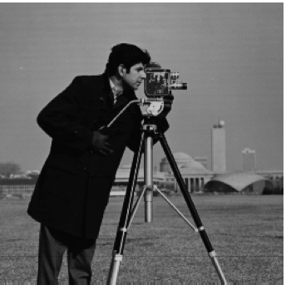
0.2 .4
.6 .8

