Slide 1
Newton Fractals

Slide 2
Newton’s method
Need initial guess and derivative
Quadratic convergence
  Proof via taylor’s theorem
x_n+1 = x_n – f(x_n)/f(x_n)
Derivation from point-slope y = m*(x – x_0) + y_0:
g(x) = f’(x_0)(x-x_0) + f(x_0) solve
Solve: 0 = f’(x_0)(x_1 – x_0) + f(x_0)

Slide 4
Concerns
Convergence to different root?
What happens if the guess is bad?
Always quadratic convergence?
  Not necessarily when derivative zero
  Second derivative unbounded
  Starting guess extremely far away

Slide 5
Common uses of Newton’s method
Square root iterations
Reciprocal iterations

Slide 6
Good guess vs bad guess

Slide 7
Previous figure gives intuition
Small movements near minimum (equidistant from roots) results in next iteration being sent all over real line
Small movement also results in convergence to different root

Slide 8
In the complex plane
Newton’s method works in the complex plane with interesting results
Fractals for f(z) = z^4 – 1 below

Slide 10
f(z) = Z^5 - 1

Slide 11
f(z) = z^10 - 1

Slide 12
What is a fractal?
No agreed upon definition but have some of the following properties
Self-similarity at various scales
Complicated structures at various scales, does not simplify upon magnification
Nowhere differentiable – sharp and jagged
Non-integer fractal dimension
How can we measure this dimension?

Slide 13
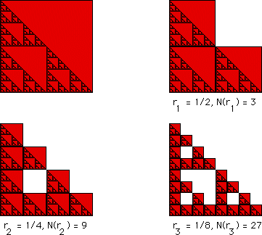
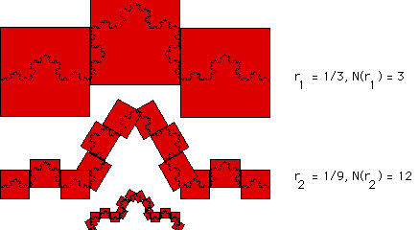
Box-counting dimension
How many boxes N of side length R are required to completely cover a fractal?
Gives a way to measure the fractal dimension
Follows formula N = N_0 * R^(-DF) where DF is the fractal dimension which is less than the dimension the figure exists in (1,2,3, etc)

Slide 14
Box-counting dimension
It’s possible to determine the box counting dimension numerically
What is the fractal dimension of our favorite Newton fractal generated from f(z) = z^3 _ 1?

Slide 15
Box-counting dimension

Slide 17
In terms of complex dynamics
Newton iterations are actually a discrete dynamical system
Dynamical system – geometrical description of how a set of points evolve over time given a fixed rule.
Set of points: complex plane
Rule: Newton iteration
Discrete because system changes in jumps, not continuously

Slide 18
Definitions
Set of all points a starting points evolves into under repeated iterations is “orbit” or “trajectory”
A point that does not change under an iteration is a fixed point. All roots are fixed points.
Basins of attraction for a fixed point – set of all starting points that eventually “land” at the fixed point and remain there
There are also attractive cycles – points with finite orbits that do not contain a fixed point.

Slide 20
Definitions
Fatou set – union of all basins of attraction and attractive cycles
  Points in Fatou set behave normally/regularly. Orbits of points behave similarly to their neighbours
Julia set – compliment of Fatou set.
  Orbits of points in Julia set are chaotic and tiny perturbations of points in the Julia set result in large, chaotic changes in orbits. Found on boundaries of basins of attracton.

Slide 22
Relaxed Newton’s Method
Roots of multiplicity greater than 1 result in slower than quadratic convergence, typically linear
Function has a root of known multiplicity m? Take the mth root of that function to reduce it to a simple root
Iterations become x_n+1 = x_n – m * f(x_n)/f’(x_n)

Slide 23
10 iterations of Reg newt on f(z) = (z-1)(z-2)(z-3)

Slide 24
10 iterations of Regnewt on f(z) = (z-1)(z-2)^2(z-3)

Slide 25
10 iterations ofRelnewt on f(z) = (z-1)(z-2)^2(z-3)

Slide 26
Relaxed newton
You can perform relaxed newton on any function regardless of root though points might never converge.
Generally 0 < m < 1 softens the fractal pattern because iteration steps are slower but less likely to overshoot and behave chaotically
1 < m < 2 sharpens the fractal pattern. Possible faster convergence as well given optimal m

Slide 27
Soft, m = .1

Slide 28
Sharp, m = 1.9

Slide 29
Relaxed newton
Why does m need to be real?
Try imaginary and complex m

Slide 30
Newton’s method for multiple roots
Fact: f(x)/f’(x) has all simple roots where f(x) had multiple roots
More robust in achieving quadratic convergence but introduces new problems … roots of derivative
Iterations become x_n+1 = x_n – (f(x_n)f’(x_n)/(f’(x_n) – f(x_n)f’’(x_n))
Second derivative!

Slide 31
10 iterations of regnewt on f(z) = (z-1)^2(z-2)^2(z-3)^2

Slide 32
10 and 100 iterations using nmfmr

