Slide 1
Modeling predator-prey equations for Ambystoma tigrinum in the presence of phenotypic plasticity
D. Wallace, A Gillman, and the denizens of Math 23 Winter 2012

Slide 2
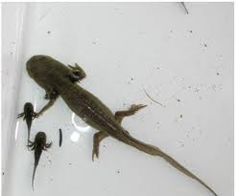
Tiger salamanders Paedomorph adult and young of the year. P, Y

Slide 3
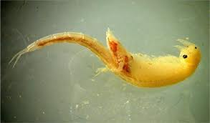
What do young of the year eat? Small things such as this fairy shrimp. F

Slide 4
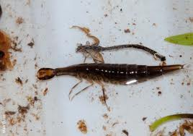
Other things eat the smallest also, such as beetle larva like this one. B

Slide 5
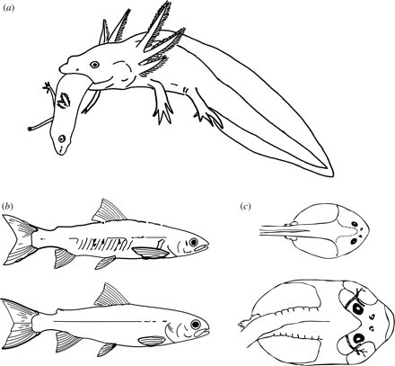
Two forms of older Ambystoma juveniles: ordinary and cannibalistic. One is eating the other. Both will also eat B and Y. (Bottom images are fish). J, C

Slide 6
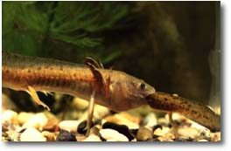
The live version.

Slide 7
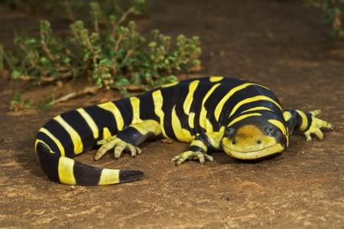
A mature terrestrial adult Tiger Salamander. In our model these eat B and may or may not have other sources of food. A

Slide 8
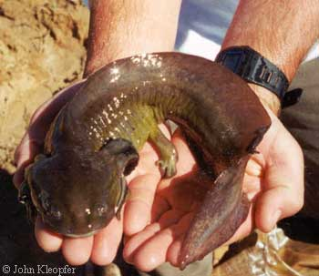
A mature paedomorph. These eat B and some Y. P

Slide 9
What do we have to account for?
Basis of food chain (F)
Larger prey (B)
Young of the Year salamanders (Y)
Juveniles (J)
Paedomorphs (P)
Terrestrial adults (A)
Juvenile cannibals (C)
Adult cannibal paedomorphs (K)

Slide 10
P
A
K
J
C
All populations--
Arranged by
Mouth size
More or less . . .
Who eats whom?
Who gives birth do whom?
Who matures into whom?
B
Y
F

Slide 11
P
A
K
J
C
B
Y
F

Slide 12
P
A
K
J
C
Y
Ambystoma maturation only

Slide 13
P
A
K
J
C
B
Y
F
Birth (green and red) and Death (purple)

Slide 14
P
A
K
J
C
B
Y
F
Predation

Slide 15
P
A
K
J
C
B
Y
F
Predation that goes into maturation

Slide 16
P
A
K
J
C
B
Y
F
Predation that goes into offspring production

Slide 17
Some equations: note logistic growth of F
F' = 10*F*(1-F) - 2*B*F - 2*Y*F
B' = (1*2*B*F - (.5*P+ .5*A + .1*K + .5*J +.1*C)*B -.001*B)
Y' = (.3*(P*(.1*Y+.5*B) + .5*A*B) +
.3*(.1*K*B + K*(.1*P+.1*A+.2*J +.1*Y) + .3*.2*K*C)
- (.1*K + .5*C + .1*P)*Y - .05*2*Y*F - .001*Y)
J' = .9*.05*2*Y*F - (.5*C + .2*K)*J - .02*.5*J*B -.001*J
C' = .1*.05*2*Y*F - .2*C*K - .02*C*(.5*Y + .1*B + .5*J) - .001*C
K' = .02*C*(.5*Y + .1*B + .5*J) - .001*K
A' = .02*.9*.5*J*B -.1*K*A- .001*A
P' = .02*.1*.5*J*B - .1*K*P- .001*P

Slide 18
Some equations: Note F,B, predator prey
F' = 10*F*(1-F) - 2*B*F - 2*Y*F
B' = (1*2*B*F - (.5*P+ .5*A + .1*K + .5*J +.1*C)*B -.001*B)
Y' = (.3*(P*(.1*Y+.5*B) + .5*A*B) +
.3*(.1*K*B + K*(.1*P+.1*A+.2*J +.1*Y) + .3*.2*K*C)
- (.1*K + .5*C + .1*P)*Y - .05*2*Y*F - .001*Y)
J' = .9*.05*2*Y*F - (.5*C + .2*K)*J - .02*.5*J*B -.001*J
C' = .1*.05*2*Y*F - .2*C*K - .02*C*(.5*Y + .1*B + .5*J) - .001*C
K' = .02*C*(.5*Y + .1*B + .5*J) - .001*K
A' = .02*.9*.5*J*B -.1*K*A- .001*A
P' = .02*.1*.5*J*B - .1*K*P- .001*P

Slide 19
Some equations: when J eats B it uses some of the energy to mature.
F' = 10*F*(1-F) - 2*B*F - 2*Y*F
B' = (1*2*B*F - (.5*P+ .5*A + .1*K + .5*J +.1*C)*B -.001*B)
Y' = (.3*(P*(.1*Y+.5*B) + .5*A*B) +
.3*(.1*K*B + K*(.1*P+.1*A+.2*J +.1*Y) + .3*.2*K*C)
- (.1*K + .5*C + .1*P)*Y - .05*2*Y*F - .001*Y)
J' = .9*.05*2*Y*F - (.5*C + .2*K)*J - .02*.5*J*B -.001*J
C' = .1*.05*2*Y*F - .2*C*K - .02*C*(.5*Y + .1*B + .5*J) - .001*C
K' = .02*C*(.5*Y + .1*B + .5*J) - .001*K
A' = .02*.9*.5*J*B -.1*K*A- .001*A
P' = .02*.1*.5*J*B - .1*K*P- .001*P

Slide 20
Some equations: when K eats J, some of the energy goes into producing Y
F' = 10*F*(1-F) - 2*B*F - 2*Y*F
B' = (1*2*B*F - (.5*P+ .5*A + .1*K + .5*J +.1*C)*B -.001*B)
Y' = (.3*(P*(.1*Y+.5*B) + .5*A*B) +
.3*(.1*K*B + K*(.1*P+.1*A+.2*J +.1*Y) + .3*.2*K*C)
- (.1*K + .5*C + .1*P)*Y - .05*2*Y*F - .001*Y)
J' = .9*.05*2*Y*F - (.5*C + .2*K)*J - .02*.5*J*B -.001*J
C' = .1*.05*2*Y*F - .2*C*K - .02*C*(.5*Y + .1*B + .5*J) - .001*C
K' = .02*C*(.5*Y + .1*B + .5*J) - .001*K
A' = .02*.9*.5*J*B -.1*K*A- .001*A
P' = .02*.1*.5*J*B - .1*K*P- .001*P

Slide 21
Some equations: predators must have a death term
F' = 10*F*(1-F) - 2*B*F - 2*Y*F
B' = (1*2*B*F - (.5*P+ .5*A + .1*K + .5*J +.1*C)*B -.001*B)
Y' = (.3*(P*(.1*Y+.5*B) + .5*A*B) +
.3*(.1*K*B + K*(.1*P+.1*A+.2*J +.1*Y) + .3*.2*K*C)
- (.1*K + .5*C + .1*P)*Y - .05*2*Y*F - .001*Y)
J' = .9*.05*2*Y*F - (.5*C + .2*K)*J - .02*.5*J*B -.001*J
C' = .1*.05*2*Y*F - .2*C*K - .02*C*(.5*Y + .1*B + .5*J) - .001*C
K' = .02*C*(.5*Y + .1*B + .5*J) - .001*K
A' = .02*.9*.5*J*B -.1*K*A- .001*A
P' = .02*.1*.5*J*B - .1*K*P- .001*P

Slide 22
Some equations: the points of morphological choice
F' = 10*F*(1-F) - 2*B*F - 2*Y*F
B' = (1*2*B*F - (.5*P+ .5*A + .1*K + .5*J +.1*C)*B -.001*B)
Y' = (.3*(P*(.1*Y+.5*B) + .5*A*B) +
.3*(.1*K*B + K*(.1*P+.1*A+.2*J +.1*Y) + .3*.2*K*C)
- (.1*K + .5*C + .1*P)*Y - .05*2*Y*F - .001*Y)
J' = .9*.05*2*Y*F - (.5*C + .2*K)*J - .02*.5*J*B -.001*J
C' = .1*.05*2*Y*F - .2*C*K - .02*C*(.5*Y + .1*B + .5*J) - .001*C
K' = .02*C*(.5*Y + .1*B + .5*J) - .001*K
A' = .02*.9*.5*J*B -.1*K*A- .001*A
P' = .02*.1*.5*J*B - .1*K*P- .001*P

Slide 23
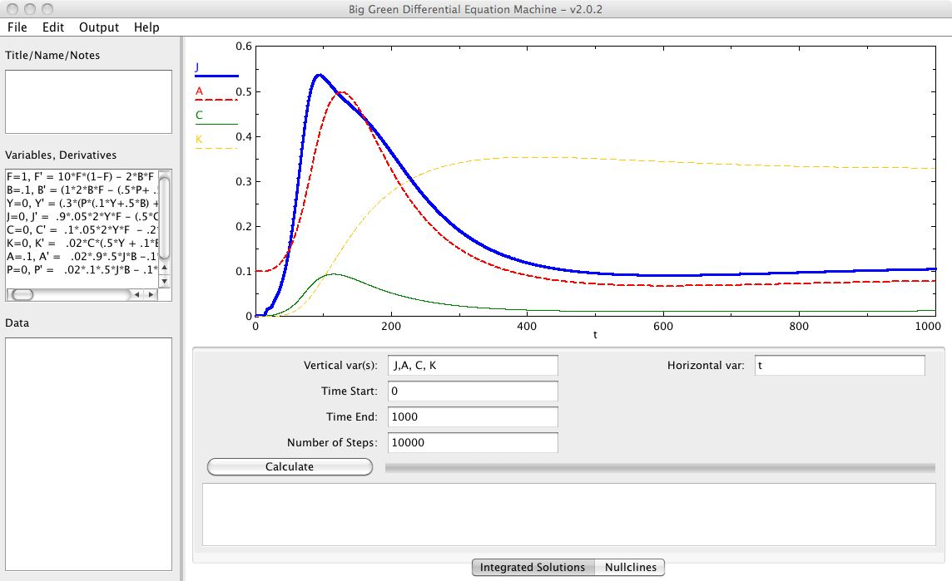
These run on big green and go to equilibrium:

Slide 24
P
A
J
B
Y
F
Submodel with no cannibalistic morphs

Slide 25
A
K
J
C
B
Y
F
Submodel with no paedomorphs

Slide 26
P
K
J
C
B
Y
F
Submodel with no terrestrial adults

Slide 27
P
J
B
Y
F
Submodel with only paedomorphs

Slide 28
A
J
B
Y
F
Submodel with only terrestrial adults

Slide 29
K
C
B
Y
F
Submodel with only cannibalistic morphs

Slide 30
P
A
K
J
C
B
Y
F

Slide 31
What do I do now?
Put your names on the signup sheet and REMEMBER your problem.
Read what we send you
Put the equations on software and make sure they run
Find equilibrium numerically
Compute the Jacobian
Evaluate it at the equilibrium you found
Use software to find all eight eigenvalues
Start your own particular problem (to be posted on web)

