Slide 1
Hi!

Slide 2
Goals
Reflect on math camp & course
Discuss what’s available at DCAL and Ed Tech and why you should visit us
Active Learning; Innovative Teaching
Psychological Interventions
stereotype threat
Assessments
Resources

Slide 3
3-step interviews (modified)
In groups, interview each other (listen and take notes, but don’t respond):
What do you think was most successful in the math camp(s)?
What didn’t work as well as you would have liked?
Rotate interviewer and interviewee and repeat
Introduce each other and share answers with the other group; summarize successes and opportunities for improvement
A interviews B
B interviews C
C interviews A
A summarizes B to others
B summarizes C to others
C summarizes A to others

Slide 4
Snowball assessment
What worries you about the upcoming year?

Slide 5
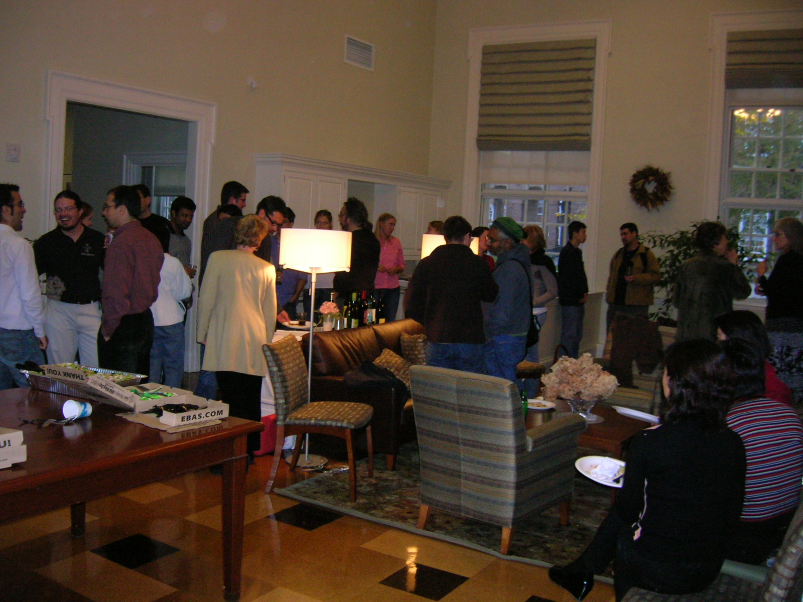
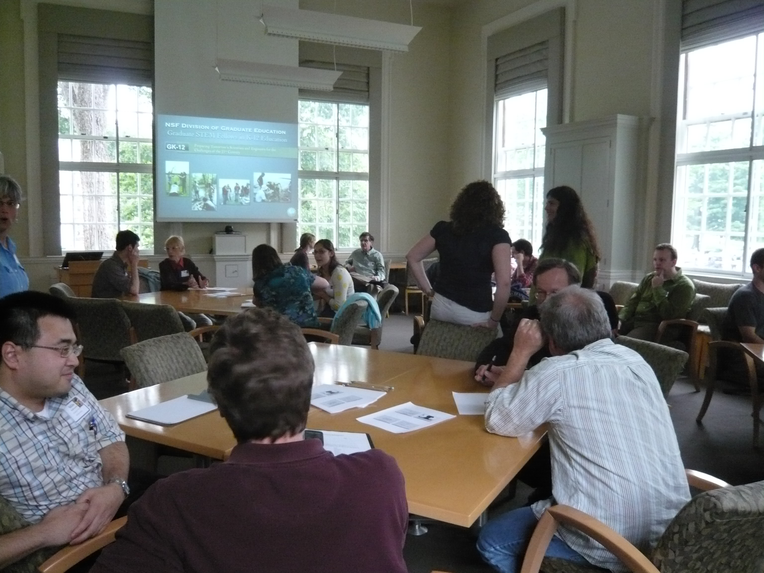
DCAL = Dartmouth Center for the Advancement of Learning
www.dartmouth.edu/~dcal

Slide 6
Future Faculty Programs
Future Faculty Teaching Series
Syllabus Design Workshop Series
Teaching Statement Workshops
Communicating Your Research to Broad Audiences
Science Education Outreach (GK-12 Next)
Learning Community for Future Faculty
TA Workshop Series/Orientation
individual consultations
class observations
and more!

Slide 7
Faculty Programs
Active Learning Institute
Faculty Voice Group
Teaching Science Seminar
Special Topics
Teaching with Technology (TWIT) – collaboration with Ed Tech
individual consultations
class observations
and more!

Slide 8
Leveraging Openly Available Course Materials To Enhance Student Learning
What are the benefits to student learning of openly available and reusable materials? What resources are available to you for discovering, reusing, remixing, and redistributing educational materials for your courses, and licensing your own for reuse too?
Find out about open education resources and tools, and how to apply Fair use and Creative Commons licenses to your own course materials.

Slide 9
Teaching Science Seminar
??? will share some simple techniques to make interaction and discovery a key part of regular teaching. These include in-class worksheets, live demos, and “detective-style” homework - all of which boost the level of engagement, social interaction, and fun. There will be time for open brainstorming and sharing of ideas for successful interactive learning in the classroom.

Slide 10
Teaching Science Seminar
Have you heard about team-based learning (TBL) but wonder how it might work in your classroom? Ann Clark (Psychological and Brain Sciences) will lead a discussion about how she has implemented TBL in her classroom, student reaction to this format, and lessons learned.

Slide 11
Teaching Science Seminar
The session — a Master Class in science communication — will be led by Alan Alda, best known for his award-winning work in movies, theater and television. In this Seminar, Alda will describe his interest in helping scientists to communicate more clearly and vividly with the public, and will demonstrate his pioneering use of improvisational theater exercises to help scientists learn to connect more directly with people outside their field.

Slide 12
Teaching with Technology (TWIT) (Educational Technologies Group)
iPads
Clickers
Class blogs
Smart pens
Camtasia relay
Pre-course/class surveys
Mazur's Just-In-Time Teaching method
https://www.youtube.com/watch?v=wont2v_LZ1E
Flipped Classroom 101
http://sites.dartmouth.edu/itd/2013/06/11/flipped-classroom-101/

Slide 13
Educational Technologies Group
Pencasting/recording pre-class videos snippets and in-class sessions
Livescribe/Echo Pens
Camtasia Relay/Fuse
iPad webcam/LEGO hack
Just-in-Time feedback/teaching technologies
Clickers
Lecture Tools
Flipping strategies w/ online tools
Khan Academy
Canvas tools
Blogs, Wikis, Journals
reflecting on how they are learning & feel about “””the math”””
exploring real world applications/contexts for abstract math concepts
Piazza Q&A Tool
Surveys/Quizzes
pre-test/post-test

Slide 14
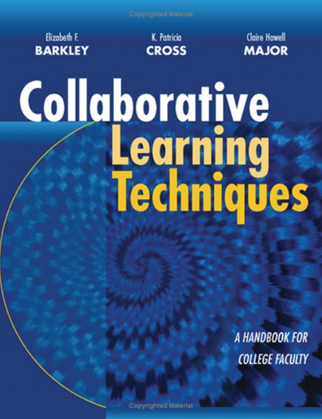
Ways to help your students
Active learning
Psychological interventions
Lots of assessments

Slide 15
Meta-analysis: Active learning and student performance in STEM
Contrast any active learning intervention with traditional lecturing (same class and institution); group activities in class, worksheets/tutorials, clickers, PBL, studios …
Occurred in a regularly scheduled course for undergrads;
Limited to changes in the conduct of class sessions (or recitation/discussion);
Involved a course in STEM: Astronomy, Bio, Chem, CS, Engineering, Geo, Math, Physics, Psych, Stats;
Included data on some aspect of academic performance — exam/concept inventory scores or failure rates (DFW).
642 papers considered, 225 met criteria and were analyzed
Freeman S, et al. (2014). Proc Natl Acad Sci USA, 10.1073/pnas.1319030111
ELI webinar: Evidence-Based Teaching: The Next Generation: ELIWEB148

Slide 16
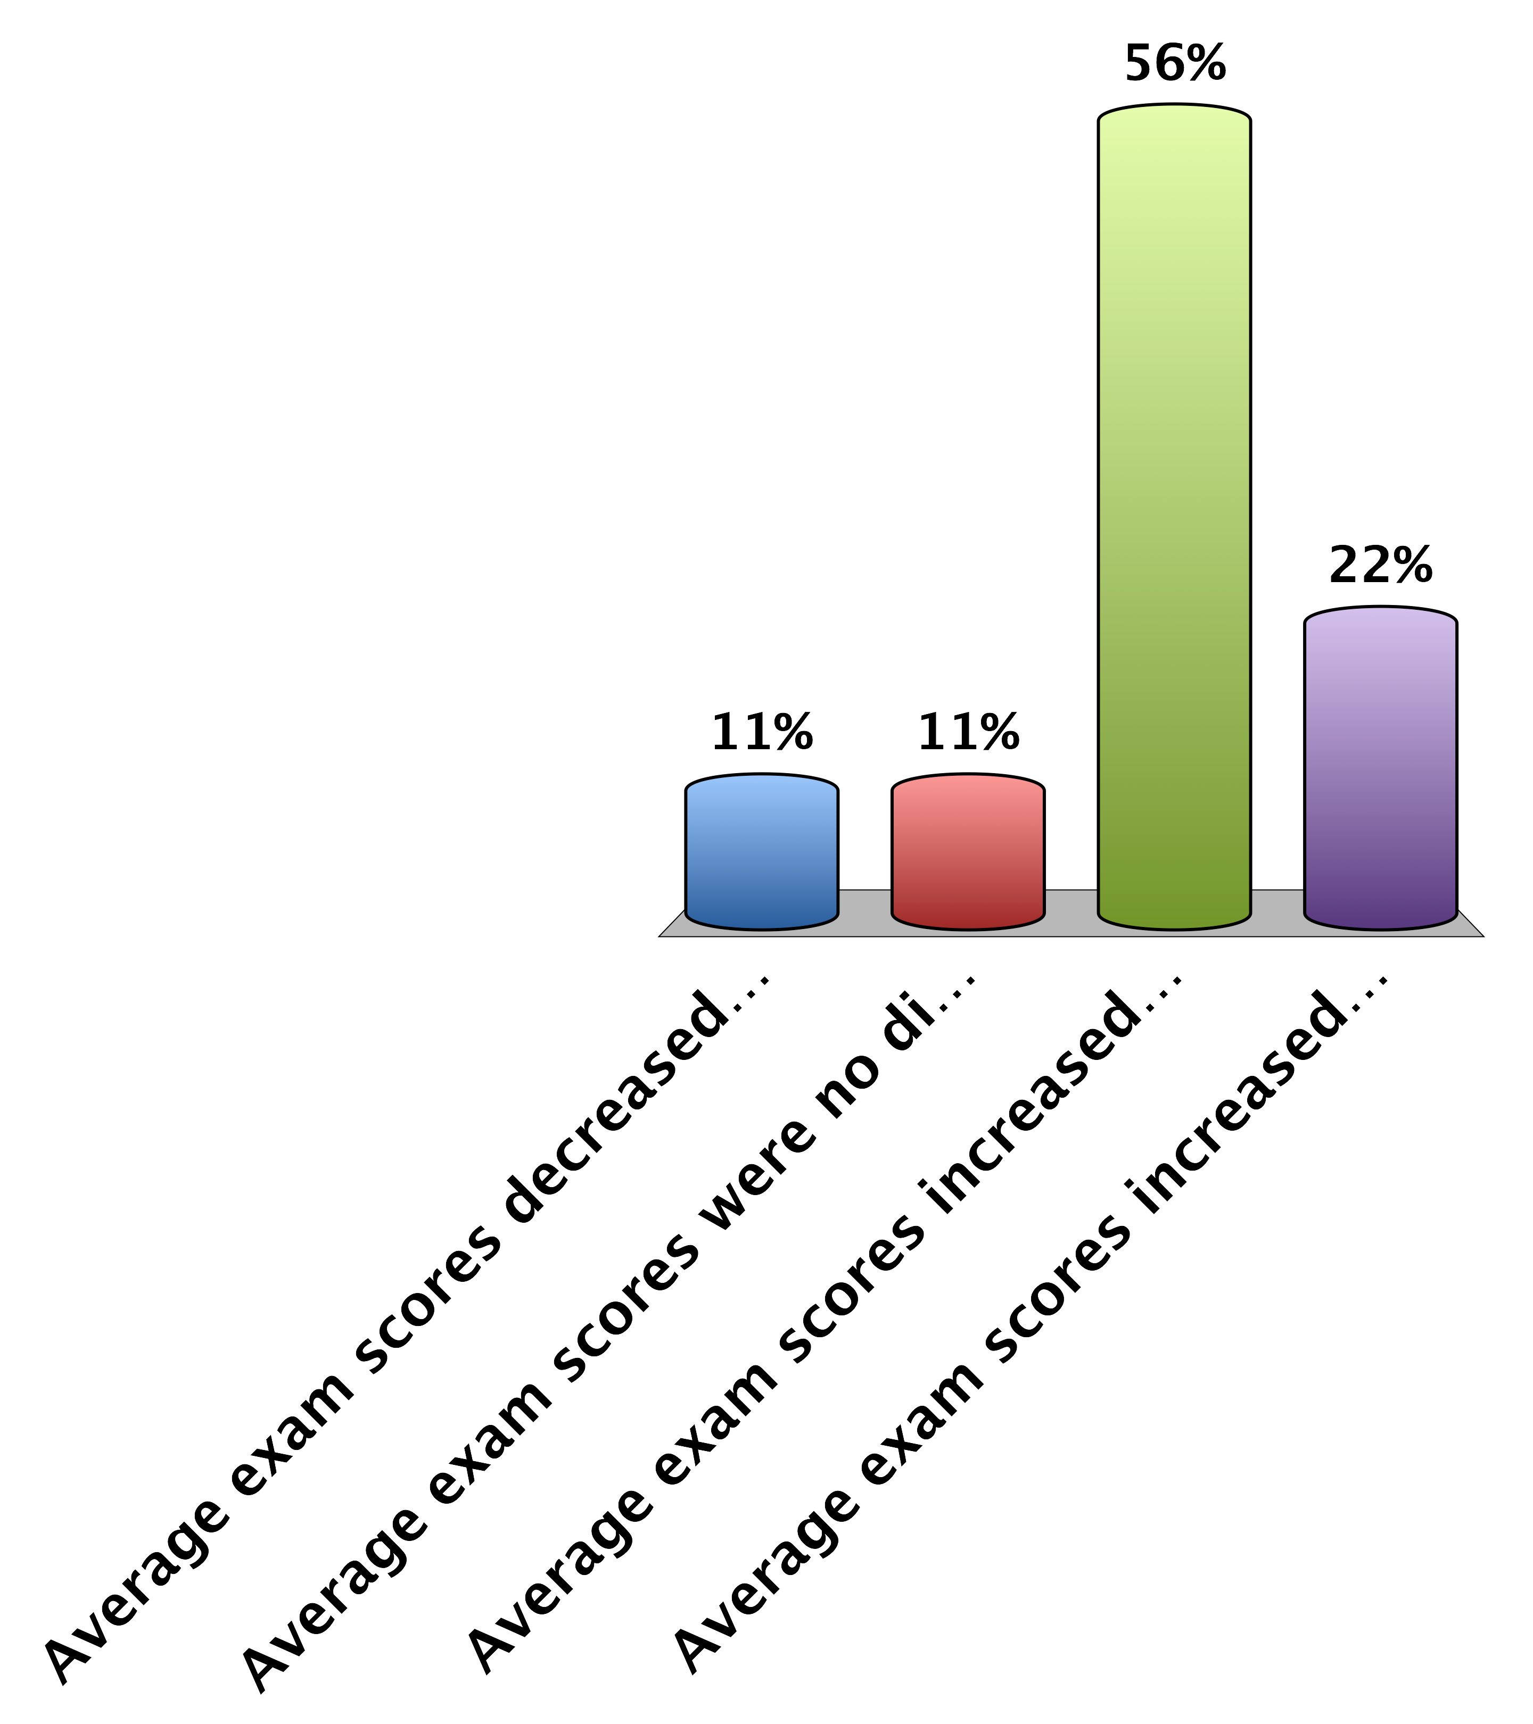
Which statement is true?
Average exam scores decreased by 7% in active learning sections compared to lecture
Average exam scores were no different in active learning sections compared to lecture
Average exam scores increased by 6% in active learning sections compared to lecture
Average exam scores increased by 14% in active learning sections compared to lecture
Freeman S, et al. (2014)
Notes:
C is answer

Slide 17
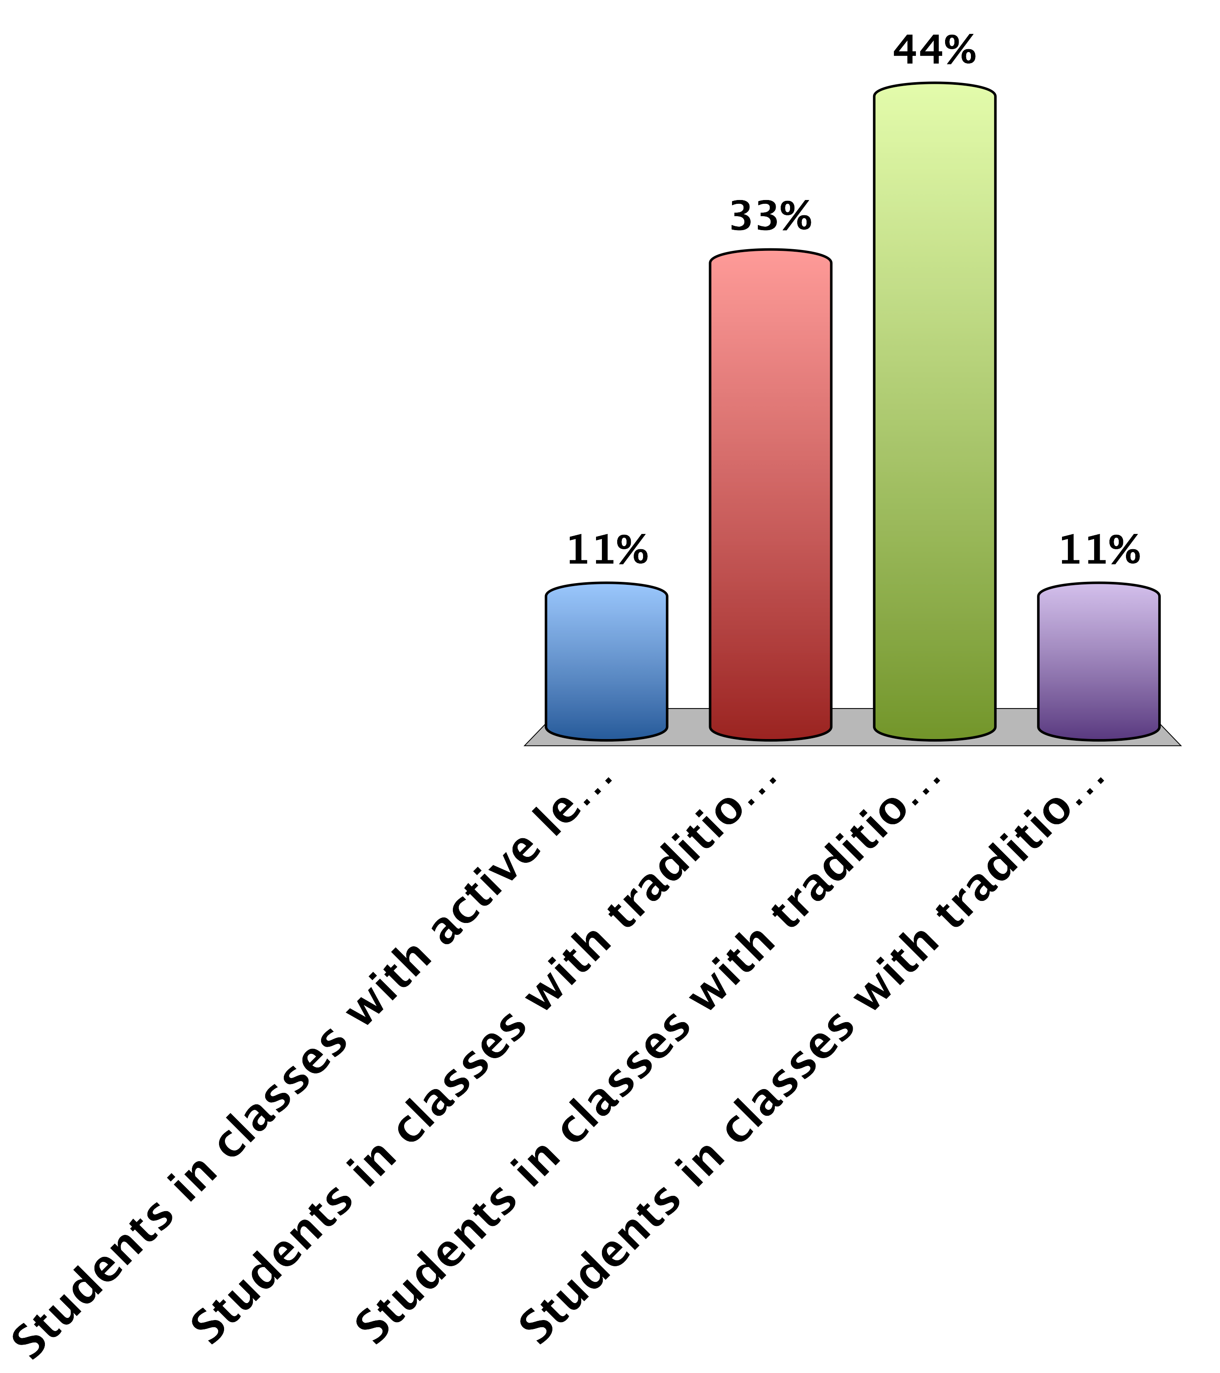
Which statement is true?
Students in classes with active learning were 1.5 times more likely to fail than students in classes with traditional lecturing
Students in classes with traditional lecturing were no more likely to fail than students in classes with active learning
Students in classes with traditional lecturing were 1.5 times more likely to fail than students in classes with active learning
Students in classes with traditional lecturing were 4 times more likely to fail than students in classes with active learning
Freeman S, et al. (2014)
Notes:
C is answer

Slide 18
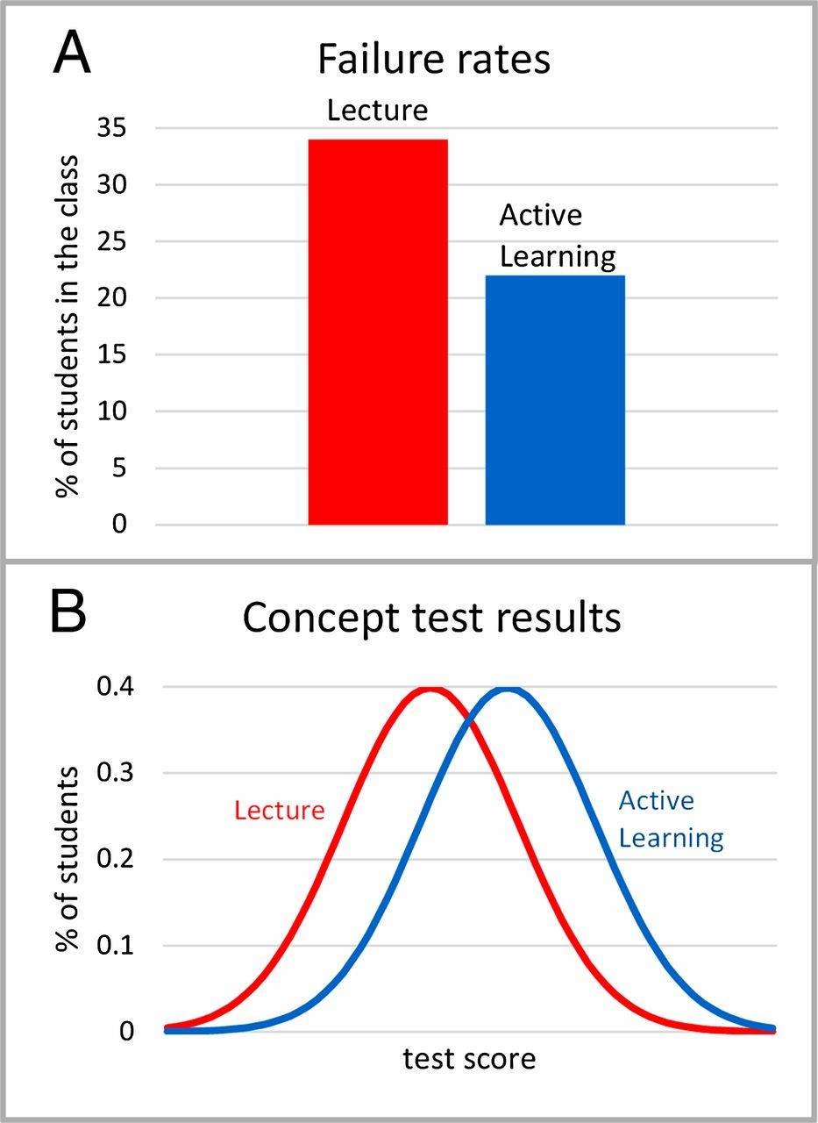
Comparisons of average results for studies reported in ref. 3.
Wieman C E PNAS 2014;111:8319-8320
©2014 by National Academy of Sciences
Notes:
Comparisons of average results for studies reported in ref. 3. (A) Failure rates for the active learning courses and the lecture courses. (B) Shift in distribution of student scores on concept inventory tests.

Slide 19
(ELI webinar: Evidence-Based Teaching: The Next Generation: ELIWEB148)

Slide 20
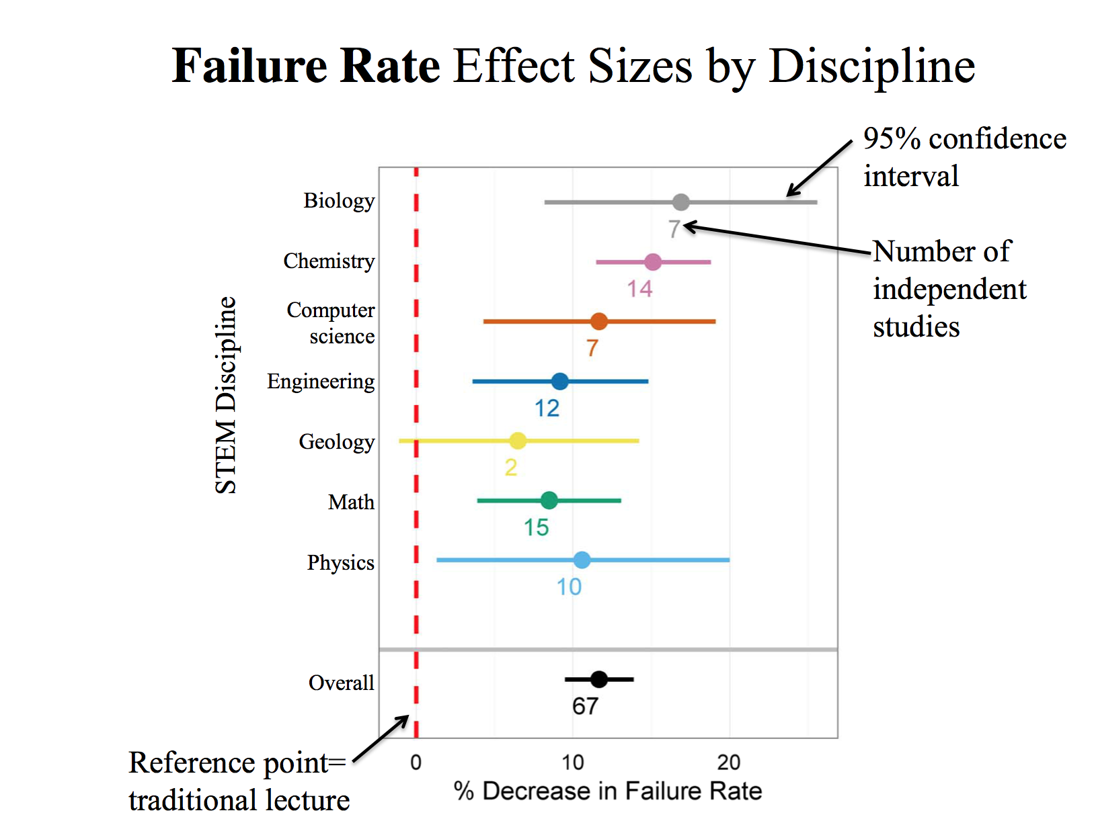
(EELIWEB148)

Slide 21
(EELIWEB148)

Slide 22
Interventions
Active learning seems to help, what else can we do?
(Hint: paper - Psychological insights for improved physics teaching)

Slide 23
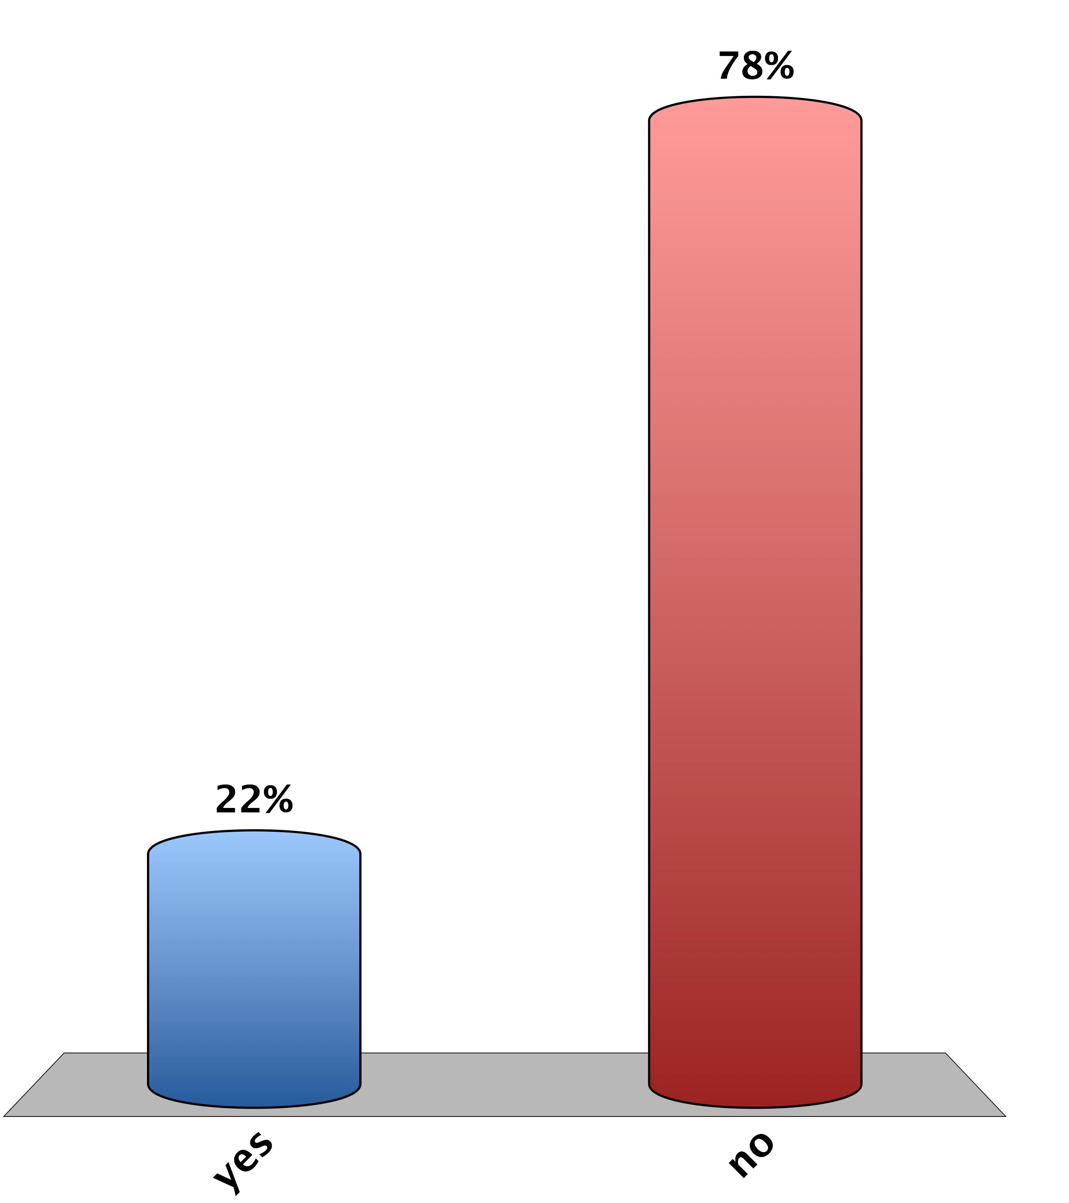
Were you ever invited to an extra help session for a class?
yes
no

Slide 24
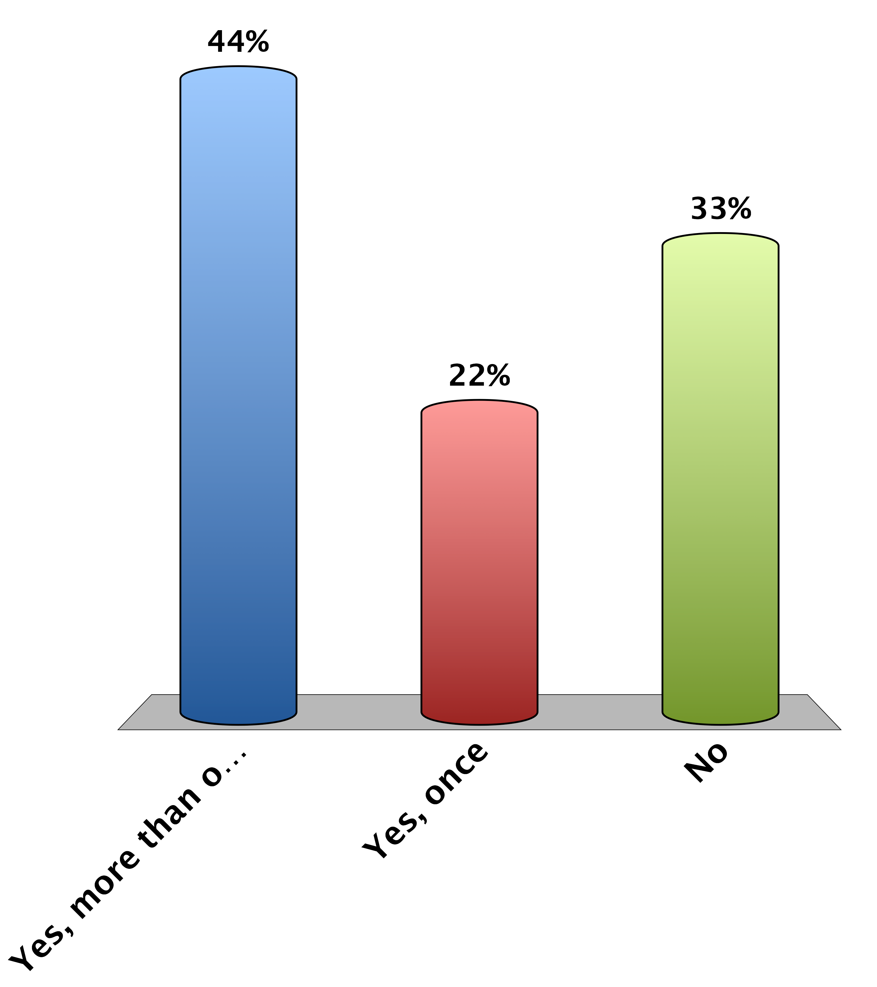
Were you ever told how difficult a class would be by the instructor at the beginning of the course?
Yes, more than once
Yes, once
No

Slide 25
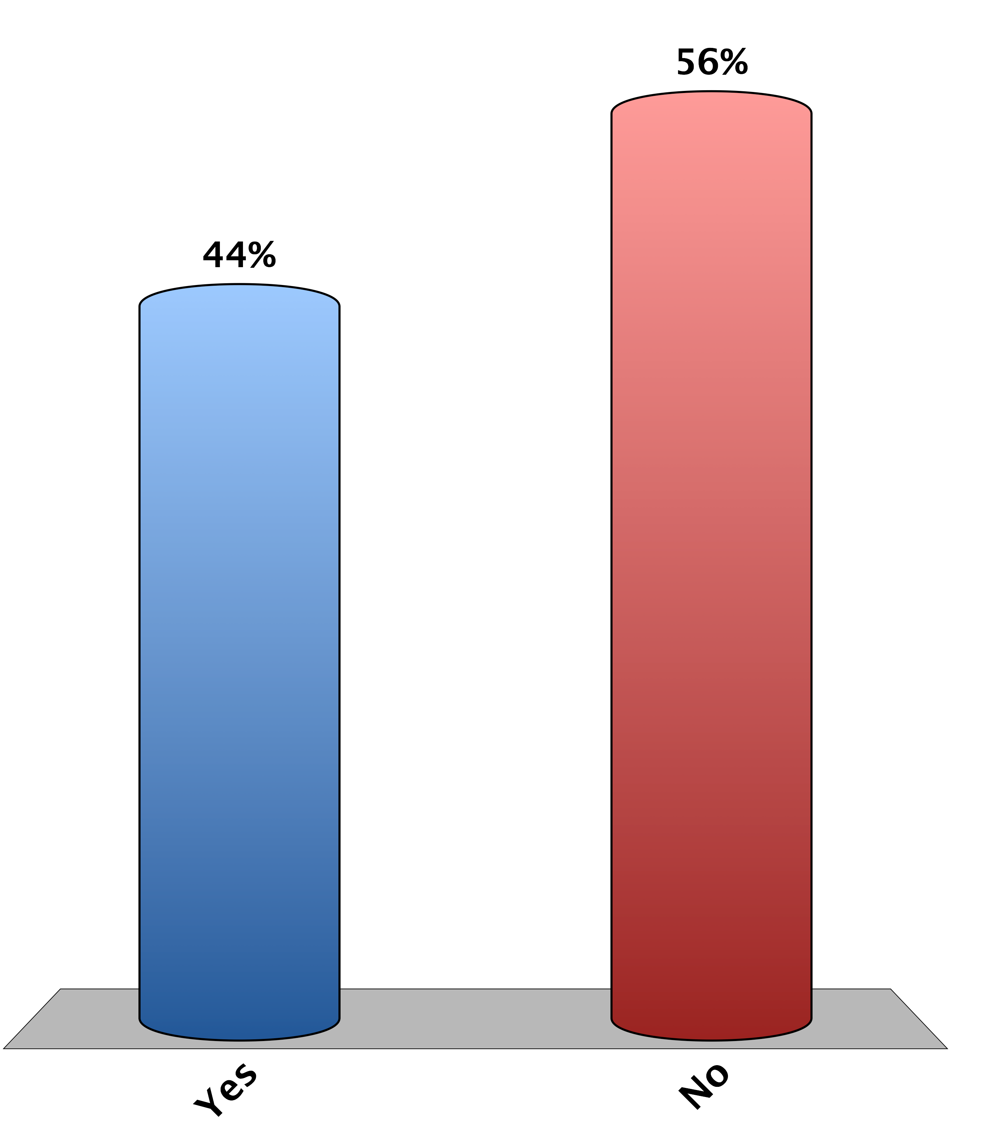
Were you ever in a class where the instructor “over-praised” students?
Yes
No

Slide 26
Article Recap
Work with a partner to list as many things as you can remember about the article “Psychological insights for improved physics teaching”

Slide 27
Your teaching (and student learning) is influenced by
Your perspectives resulting from an intersection of multiple social identities
Your experiences as a function of dynamics created by and resulting from membership in multiple social groups
What did you notice during math camp?
(or at Dartmouth or the Upper Valley or…?)
(slide based on Angela Byars-Winston, Aug 2003)

Slide 28
Under-Performance of Women In Math & Science
While outperforming men in all other areas of academia,
women earn less than 25% of the degrees in
Computer Science, Physics, and Engineering
College: women perform worse on standardized tests of mathematics but do well in their courses;
far fewer choose math/ hard science majors
Middle School: Girls earn equally high grades but begin to lose confidence in math abilities;
test score gap on standardized tests emerges
K-6: Girls Perform at or above the same level as boys on tests and in school; show less intrinsic interest in spatial tasks
(slide from Joshua Aaronson, Oct 2008)

Slide 29
(slide from S. Stroessner, May 2009)
Some Explanations for Achievement Gaps
Legacy of racism, prejudice and segregation (House, 1999; Spring, 2000)
Poverty and SES (Barton, 2003; Ferguson, 2001)
Cultural differences in language or in adaptation to school (Mercado, 2001;Ogbu, 1999, 2003; Portes, 1996, 1999)
Family and parenting (Eccles, 1994; McAdoo, 1978; Okagaki & Frensch, 1998)
Inequities in resources and opportunities to learn (Barton, 2003; Hanushek & Rivkin, 2006; Kozol, 1991; Mickelson, 2001)
Educators responses to student diversity (Delpit, 1996; Ferguson, 1998; Pollock, 2001; Spring, 2000)
Lack of role models (Dee, 2004, 2005)
Test bias (Airasian, 2001, Gould, 1981; Valencia & Suzuki, 2001)
Inherent differences in ability (Halpern, 1992; Summers, 2005)
Notes:
29

Slide 30
Stereotype Threat -> Identity Threat
Apprehension arising from the awareness of a negative stereotype or personal reputation in a situation where the stereotype or identity is relevant, and thus confirmable
everyone experiences this in some form
(slide from J. Aaronson, Oct 2008)

Slide 31
Examples of Identity Threat
Jewish person in the Bible Belt
African American Taking an IQ test
Woman called upon in math class
(slide from J. Aaronson, Oct 2008)
Notes:
An African American kid taking an IQ test, perhaps administered by a tester, feels wary that the test will reveal him to be as stupid or inferior as the stereotype alleges
A girl called upon in math class may feel extra pressure to not confirm the stereotype that relative to the boys, she’s not good at math
George W. Bush knows that lot’s of people doubt his intelligence; this may make public speaking

Slide 32
Math Test Performance Of College Men and Women (Spencer, Steele & Quinn, 1999)
(slide from J. Aaronson, Oct 2008)

Slide 33
When White Men Can’t Do Math Aronson, et al., (1999). Journal of Experimental Social Psychology.
d = .93
(slide from J. Aaronson, Oct 2008)

Slide 34
Educational Testing Service Study: Asking Gender Before AP Calculus Test
(slide from J. Aaronson, Oct 2008)
Notes:
Asking Gender Before AP Calculus Test Hurts Girls, Helps Boys

Slide 35
7th Grade Girls’ Math TAAS
Good, Aronson & Inzlicht (2003) Journal of Applied Developmental Psychology.
(slide from J. Aaronson, Oct 2008)

Slide 36
Reaffirming personal adequacy
Reduced threat by having students reaffirm their sense of personal adequacy through a classroom task:
“Write a paragraph about which of your values is most important to you.”
This simple exercise reduced the achievement gap between black and white middle schoolers by 40%.
Cohen, Garcia, Apfel & Master (2007)

Slide 37
Reducing Effects of Stereotype Threat: Strategies
De-emphasize ability & group identity; emphasize effort, persistence, individualism
Emphasize high standards and the ability of all to reach those standards
Stress the malleability of intelligence – “your brain is a muscle”
Provide exposure to Role Models
Show awareness of the external difficulties: Normalizing struggle
Groupwork that employs interdependence
(slide from J. Aaronson, Oct 2008
& S. Stroessner, May 2009)

Slide 38
Conclusion
Human intelligence, motivation, and academic self-concept is more fragile and malleable than traditionally thought. People’s performance and motivation can rise and fall depending on the situations and relationships they are in, and the mindsets they adopt.
(slide from J. Aaronson, Oct 2008)

Slide 39
Interventions can help!
Active learning
Interventions
And…

Slide 40
Assessments
This session
Math 147
Math camp

Slide 41
References
Active Learning
http://www.pnas.org/content/111/23/8410
http://www.pnas.org/content/111/23/8319
http://www.cwsei.ubc.ca/resources/papers.htm
http://www.academiccommons.org/2014/07/24/the-professor-and-the-instructional-designer-a-course-design-journey/
Psychological interventions; Stereotype threat
http://scitation.aip.org/content/aip/magazine/physicstoday/article/67/5/10.1063/PT.3.2383
http://reducingstereotypethreat.org/
http://www.msri.org/workshops/458
http://www.cirtl.net/diversityresources
https://implicit.harvard.edu/implicit/demo/

