Slide 1
Modeling Speckle Noise Using MATLAB
Adam Baldoni, Dickinson College
Mentor: Dr. Ilker Kocyigit, Dartmouth College

Slide 2
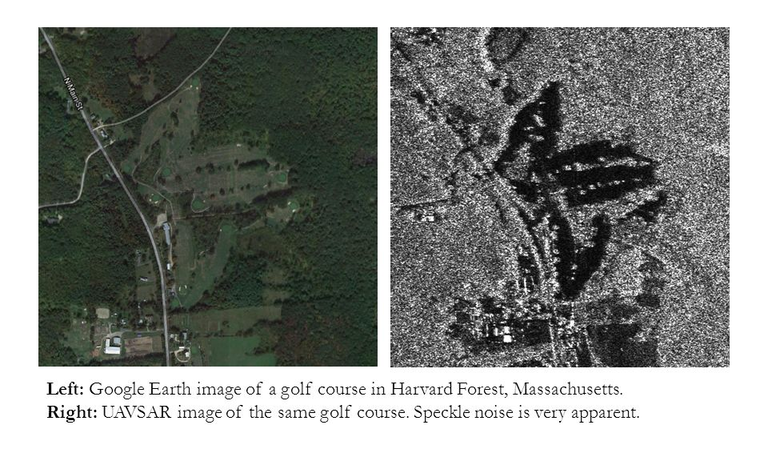
What is speckle?
Noise phenomenon that occurs in imaging

Slide 3
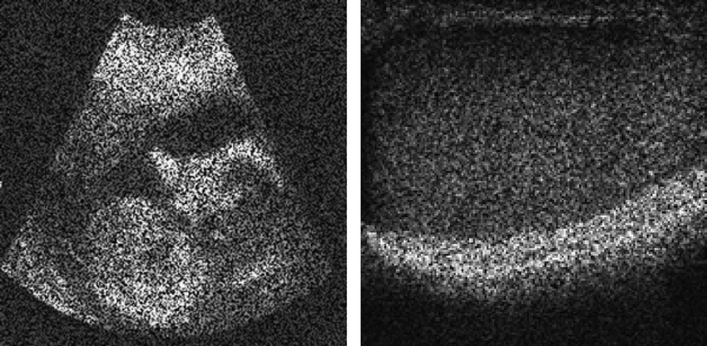
Why is speckle important?
Ultrasound
SAR

Slide 4
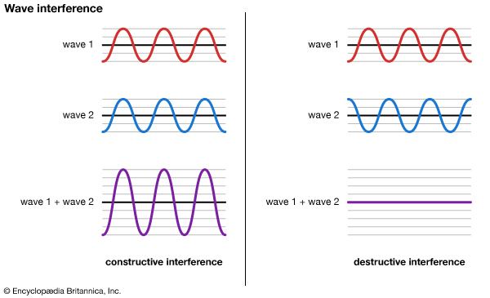
Where does speckle come from?
Approximating a surface with a reflectivity array
In reality, many scatterers in resolution cell
Causes constructive and destructive interference

Slide 5
How do we model speckle?
Multiplicative noise based on Rayleigh distribution
Take away scatterer assumptions
Many weak reflectors vs 1 strong representative scatterer

Slide 6
Basic Idea
Sensor Array
Sources/Object
a
L

Slide 7
Born Approximation and Kirchhoff Migration
Born Approx:
Discretization:
Kirchhoff Migration:

Slide 8
Resolutions and Scaling
Cross Range Resolution:
Range Resolution:

Slide 9
Building the code
First version of code assumes a strong reflector located at the center of the pixel
Second version assumes many weak reflectors located anywhere within pixel (speckle)

Slide 10
Original Image

Slide 11
First Version

Slide 12
Second Version (speckled)

Slide 13
Second Version #2

Slide 14
Obtaining statistical stability
Current version of code is not statistically stable
Technique available to increase stability
Technique causes some resolution loss

Slide 15
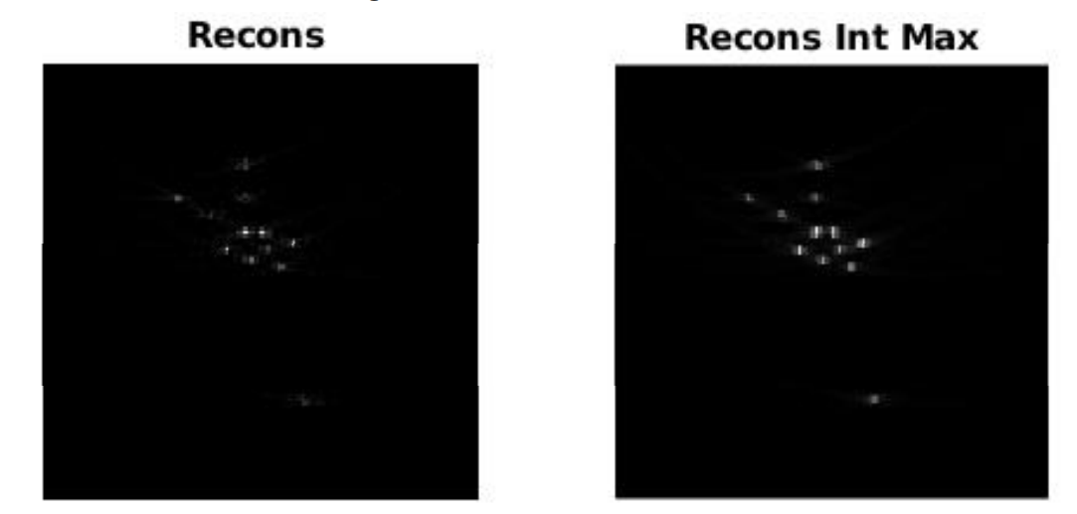
Statistical Stability Technique

Slide 16
Moving Forward
Implement self-averaging technique
Improve code efficiency
Use code to research gaining information from speckle of different objects

Slide 17
Acknowledgements
Dr. Anne Gelb
Dr. Feng Fu
Tracy Moloney
Dr. Ilker Kocyigit
REU students
Dartmouth College

Slide 18
Single vs Multiple Frequency Imaging
Single Frequency
Uses a single central frequency
Computationally less expensive
Noisy
Multiple Frequency
Uses multiple frequencies within bandwidth
Background noise cancels out
Computationally expensive

Slide 19
Single Frequency

Slide 20
Multiple Frequency

