Slide 1
Time: An Essay
Carina Conti, Jordan Greenwood,
Tramon McZeal, Kelly Mitchell,

Slide 2
Continuous Flow of Time vs. Individual Moments in Time
It was once thought that time was a continuous, non-segmented flow
Individual moments are "synthesized events in a specific way"
Can also be differentiated by moving and non-moving positions
A position change "in time" is a result of a change "in space"
"A South American lady who, on her return from Germany, mentioned as one of her most amazing experiences that there even station clocks had not only two hands indicating hours and minutes, but also a third indicating secongs" (Elias 95)

Slide 3
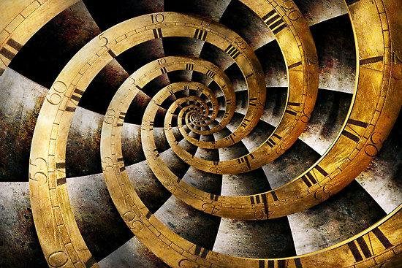
As Time Flows
Events appear as instantaneous
Time seems like a slow process
In the early stages, it was difficult to understand the "coherence" of time

Slide 4
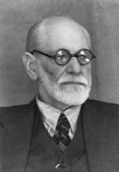
Sigmund Freud

Slide 5
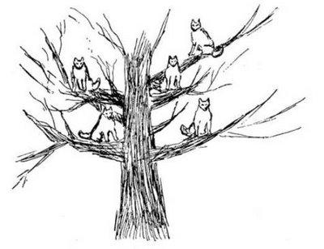
The Wolfman
Suffered from "infantile neurosis"
Freud believed that time was continuous
The Wolf Man was experiencing time in segments

Slide 6
Questions
How, in specific moments of your life, has time seemed to be moving faster or slower?
When have certain moments in your life seemed long and extraneous because time seems to be moving slowly?
Does every individual experience the flow of time differently?

Slide 7
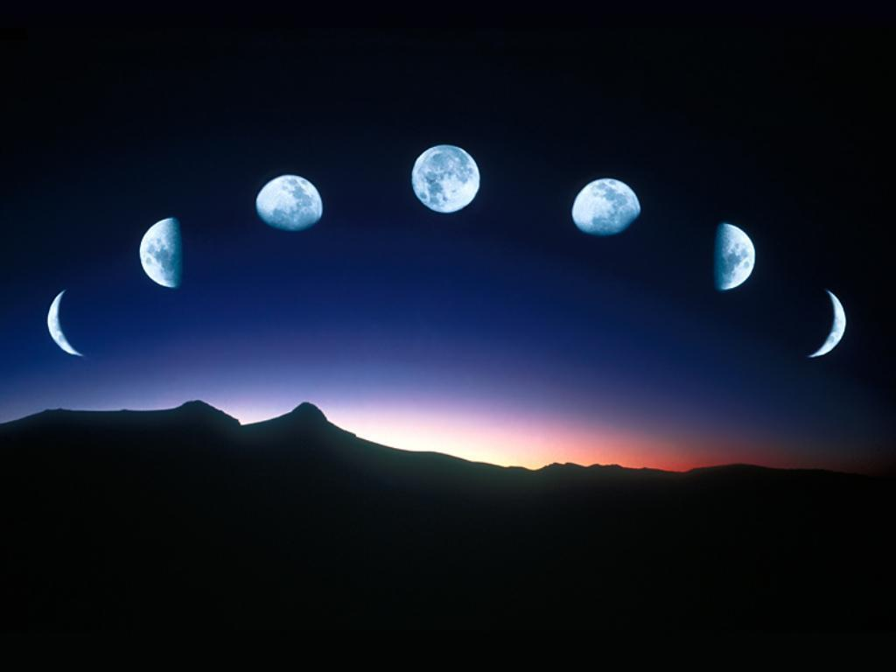
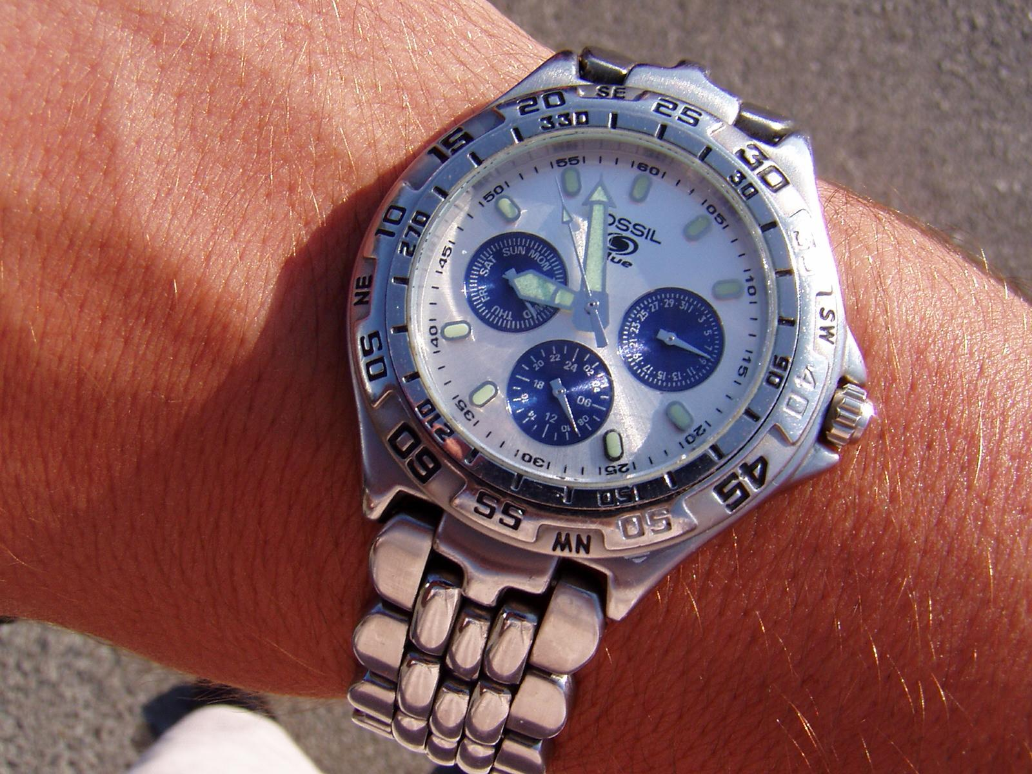
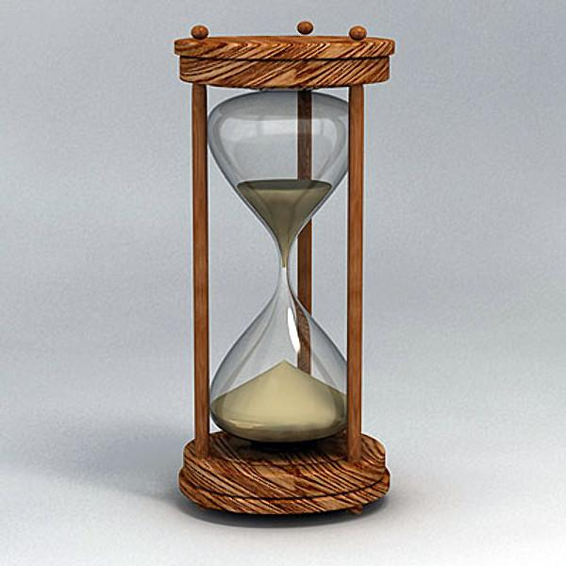
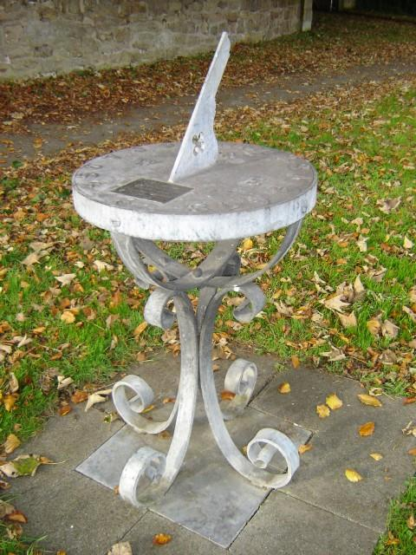
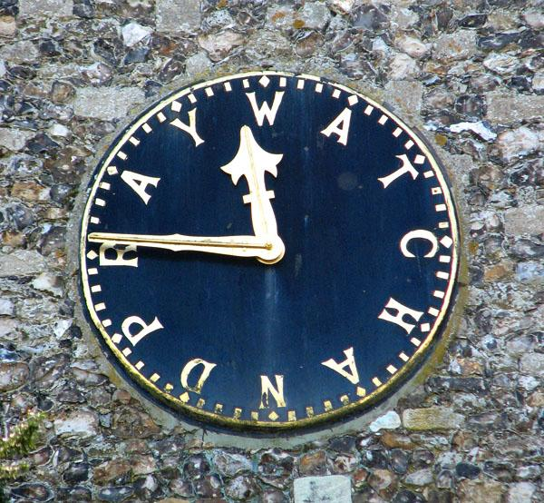
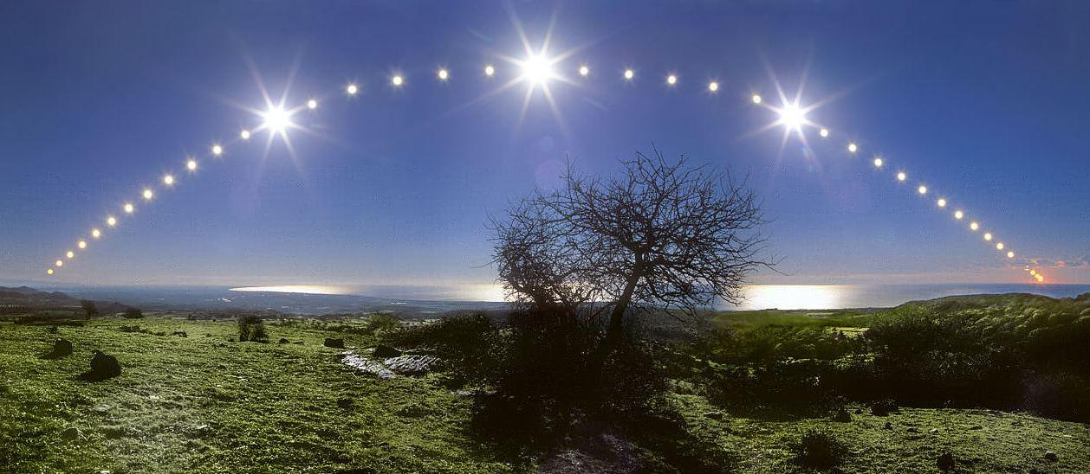
Part II: TIME METERS
\

Slide 8
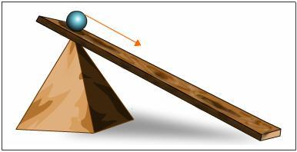
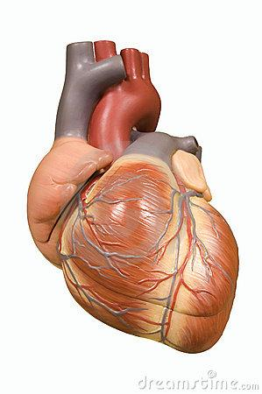
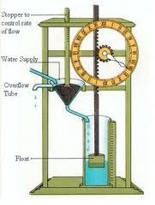
Galileo's Time Meters
Time could now be measured rather than just told.
He worked to define the meters his precursors took for granted.
  What are we really measuring?
No minutes or seconds -- This allowed him to define time more clearly, (planks and rolling balls or water)
Used a clepsydra (used for timing social affairs) systematically for natural events instead of human events.

Slide 9
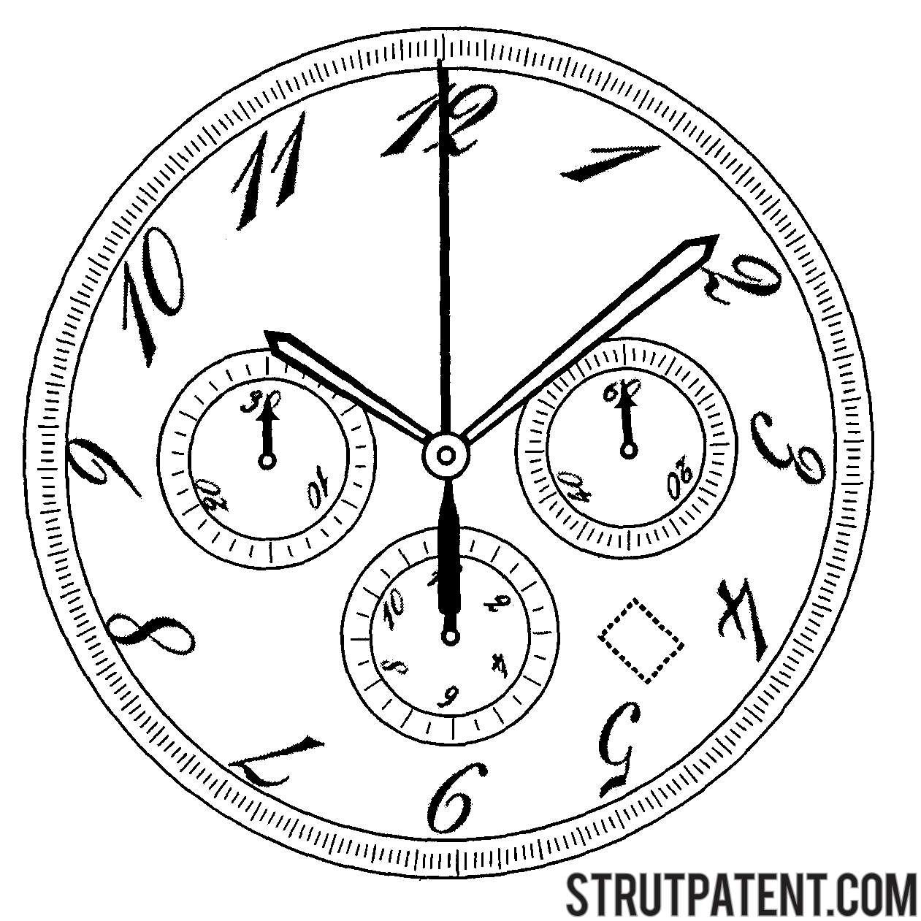
Time Meters: Applying Galileo's Logic
“The term ‘time’ is used today with reference partly to a continuous sequence of unrepeatable changes, and partly to repeatable sequences of change which, insofar as they are repeatable, are unchanging” (Elias 101).
Clocks do not register or indicate time: "Clocks, human-made or not, are simply mechanical movements of a specific type, employed by people for their own ends” (Elias 118).
  Clock hands are just objects moving at differently proportioned intervals and rates.
Physical movement creates temporal
understanding
Working to “dissect change into isolated systems,
often obscures the difference between time and
space meters, and with it, the nature of time itself.
What is the difference between temporal and
spatial time?
  Is temporal position determined by
spatial position?

Slide 10
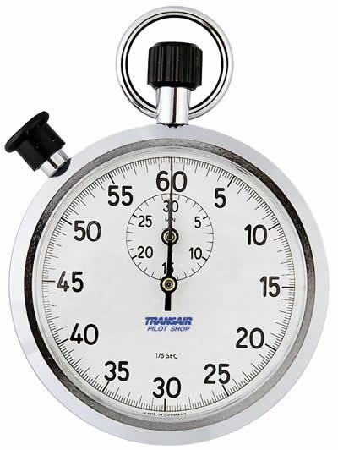
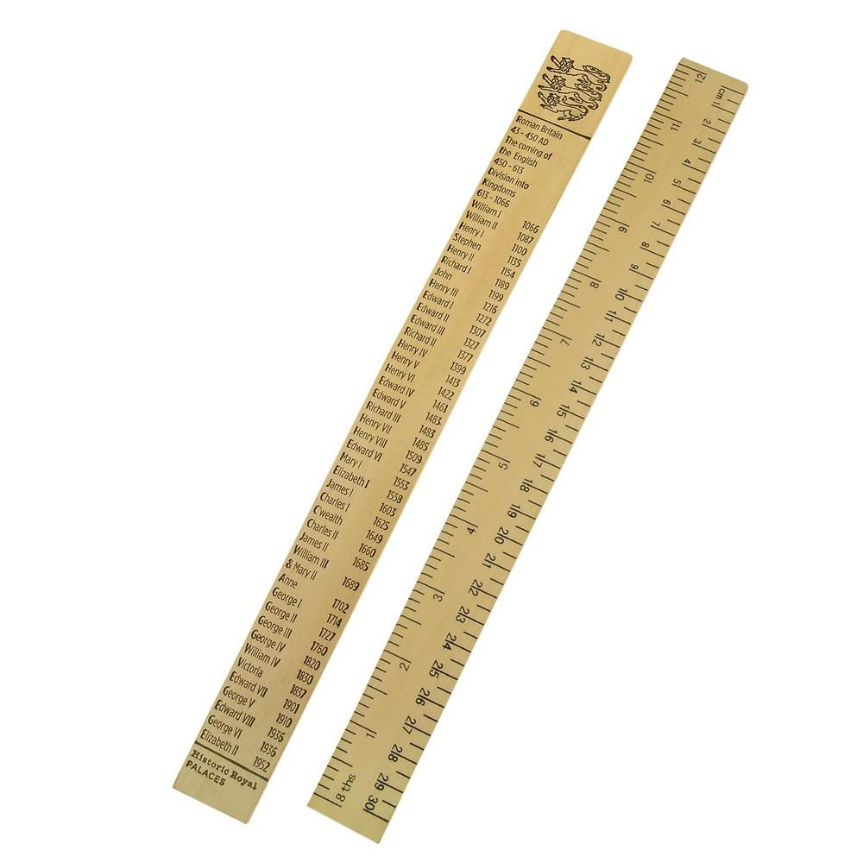
Time Meters:
The Separation of
Time and Space
"The positional relations themselves are entirely inseparable" (Elias 99).
  speed = distance/time
Basic units of measurement but are measured with different meters:
  Time: Passing sun, calendars
  Space: Ruler, reference points
Time-meters are different from other measuring devices because they are continuously moving.
  They are relatively independent of what they measure.
"Every change in 'space' is a change in 'time'; every change in 'time' a change in 'space' (Elias 100).
  But can't you sit in place while time is passing?

Slide 11


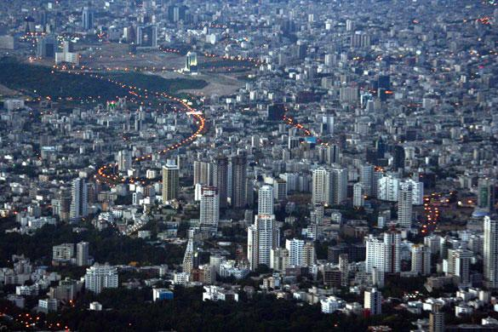
Part III: The Relationship Between Nature and Society
Nature and Society are often
regarded as separate concepts
and discourses.
Social time is the "soil" from
which physical time grew.
"If one explores 'time', one
explores people within nature,
not people and nature apart."

Slide 12
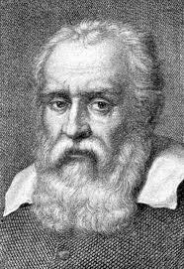
Galileo's role in forming the perception of time
Galileo's work influenced
the mechanical view of
time.
Galileo personally did
not separate the "practical"
and the "theoretical"

Slide 13
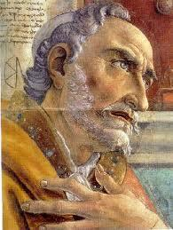
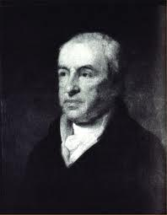
Dunlap vs. St. Augustine
St. Augustine-Time as an
extension of the
human consciousness
Dunlap-Time is perceived
through our body/physical,
"internal clock".
VS.

Slide 14
Questions
Before this class, how many times did you think of the connection between math, literature and time? Why do you think that is so important that there is a bridge between the social and physical time?
What can you see as modern consequences of this polarization of "nature" and "society"?

Slide 15
Time Across Cultures
Subjectivity of Time
"They saw the world and themselves from the perspective of the hundredth floor, without knowing how people had arrived there" (135)
Pre-Industrial Societies: Reliance on Biological Time

Slide 16
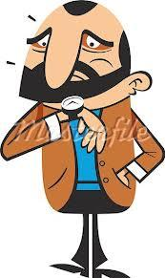
Anxiety of Time in Western Society
"There are...extreme cases where people become time-ridden, obsessed by the need not to 'waste time', to be everywhere 'on time'" (137)

Slide 17
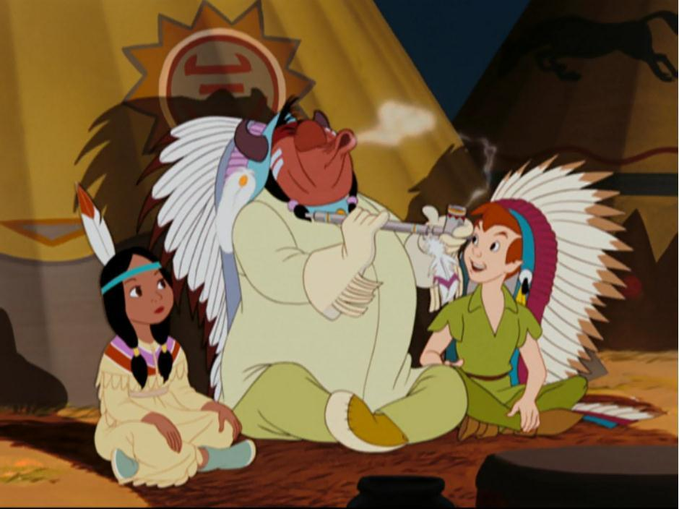
How Did We Get From Here...

Slide 18
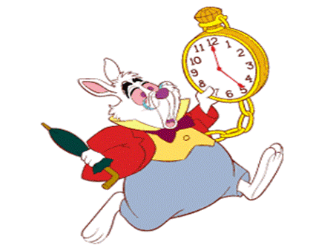
To Here?

Slide 19
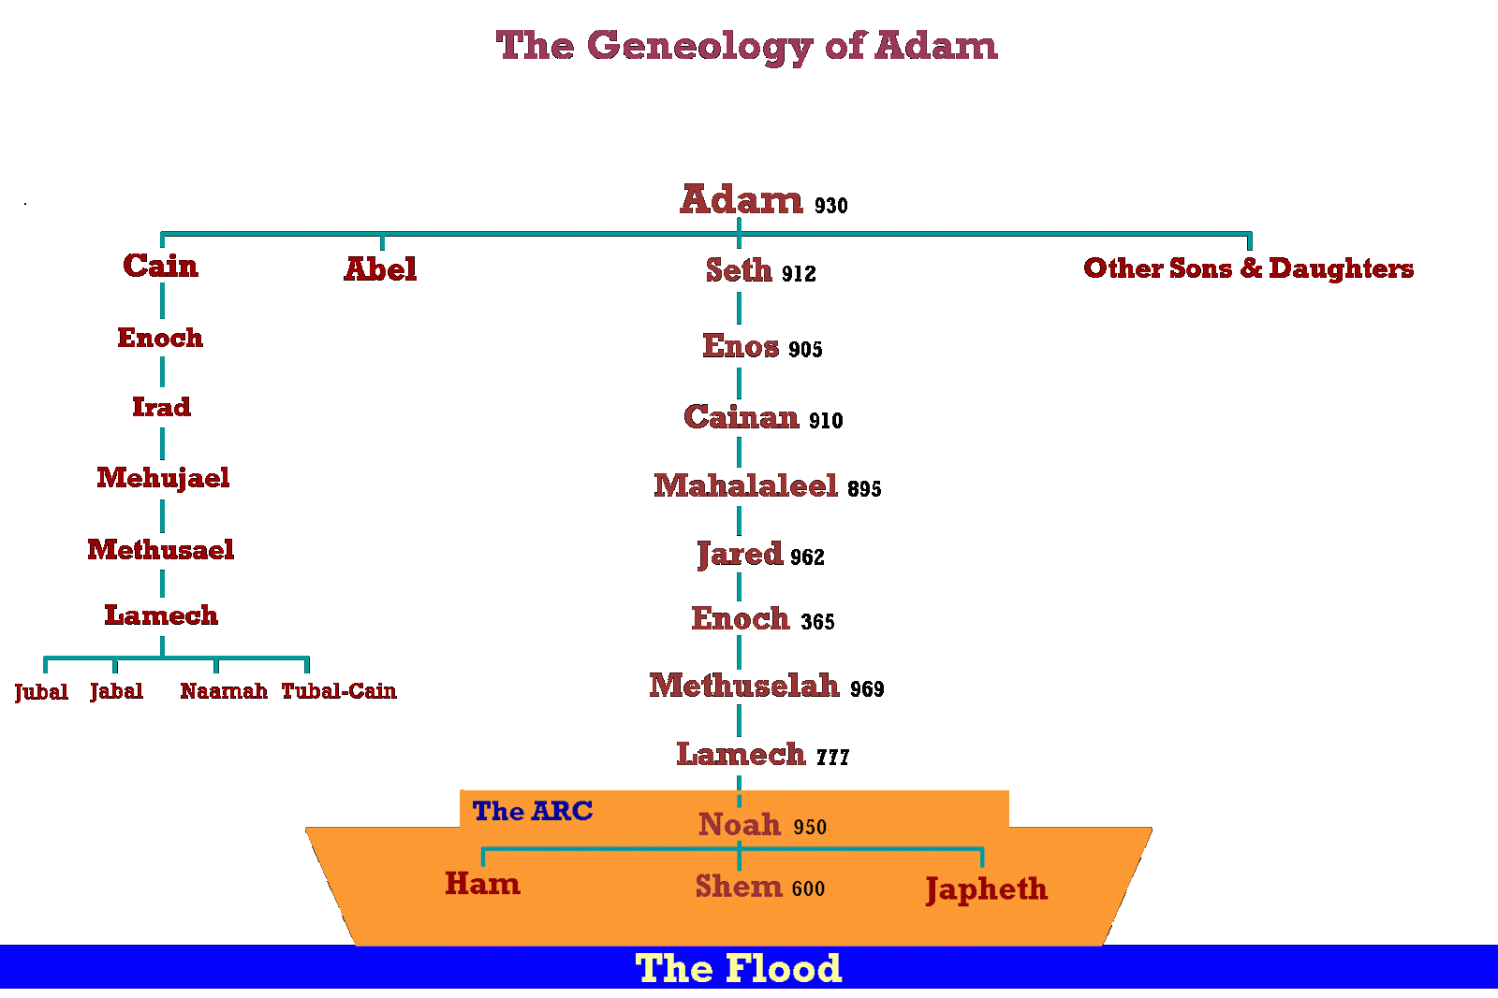
In the Beginning...
Genesis Creation Story
Establishes Time Measurements
Genealogies

Slide 20
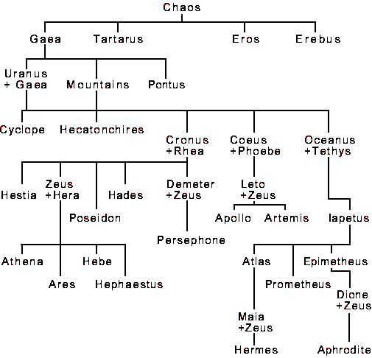
Time in Theogony
Similarities to Genesis Story: First, comes Night and Erebus.
Establishes Linear Geneologies
Flow of Time Sacred

Slide 21
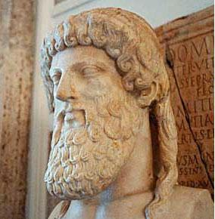
Plato: Time and Motion

Slide 22
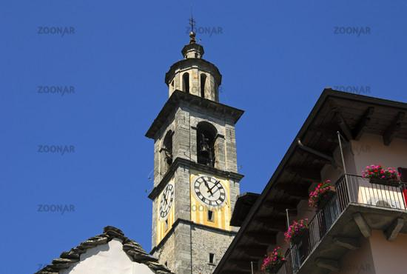
Social Awareness of Time
Public Clocks: Time becomes a constant presence
Petracrch: "Carpe Diem"
Shakespearean Sonnets: Time as Enemy

Slide 23
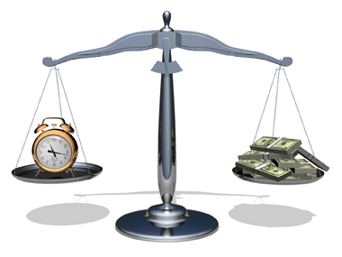
Industrial Revolution-Present
Heavy Emphasis on Efficiency
"Time is Money"

Slide 24
Questions
Are there benefits to viewing time as cyclical?
Do you think it is possible for a culture that subscribes to a linear view of time to adopt a circular view instead? Why?
What is the most accurate model of time we've been presented with(linear, circular, spiral)?

