Slide 1
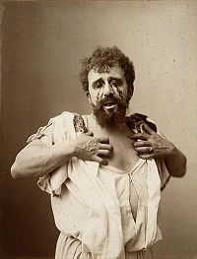
Oedipus Rex

Slide 2
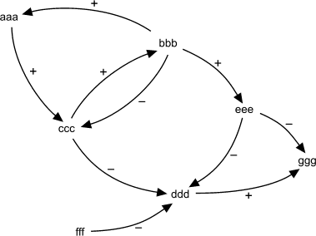
Time is not represented linearly

Slide 3
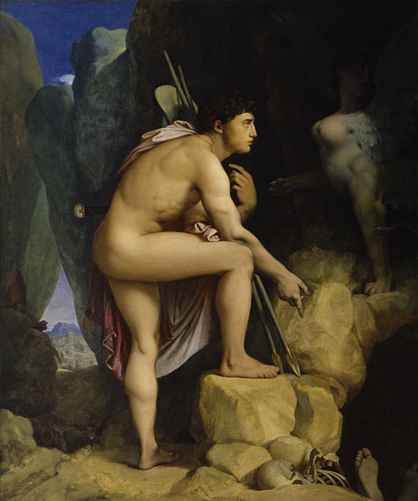
Oedipus Journey

Slide 4
Discuss
Instead of telling the events in a linear way Sophocles tells the story in a broken glass kind of way (he throws the readers in medias res). putting the middle of the story at the beginning and the beginning in the middle. What effect does this chronological rendering of the narrative have in Oedipus Rex?

Slide 5
Oedipus lack of respect for time and Age

Slide 6
Oedipus hits an old man and shows him no respect. This shows his general disregard for those who are older than himself. Do you think Sophocles is trying to portray Oedipus as someone who does not respect time?

Slide 7
Time as a Factor Influencing Interpersonal Relationships in Oedipus
Sophocles’ use of Oedipus’ character as a device to examine the relative meaning of time on the relationships of individuals at different stages of their lives (i.e., Jocasta v. Oedipus, etc.)

Slide 8
Deconstructing the Myth of Time as “Linear” in Oedipus Rex
Sophocles not only uses plotline and series of events to disbar the notion that time is a “linear” construct, but he also uses the occurrence seemingly bizarre or unnatural interpersonal relationships to skew our perception of time as a constant, linear progression of human existence.

Slide 9
The Power v. Time Dialectic in Oedipus

Slide 10
Question
What do you think Sophocles is trying to show by the coincidence in the timing of so many events in his story?
What does this say about the nature of time and its relation to destiny, and perhaps the psychological effect that it has on Oedipus?

Slide 11
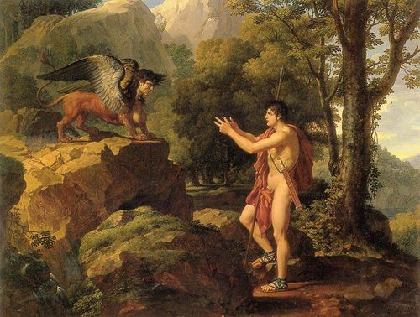
Incest

Slide 12
Does Sophocles purposely portray Oedipus as blind to the age of people? And is this the real reason for the downfall of the character?

Slide 13
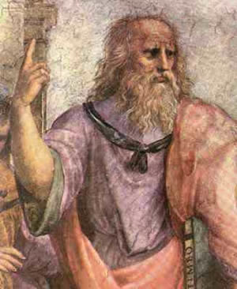
Plato’s Timaeus
360 BC

Slide 14
Defining Time
Time: “an eternal moving image of the eternity which remains for ever at one.”
Part of this time was creating nights, days, months, years, past and future
“The sun and moon and five planets…came into being to define and preserve the measures of time.”
Time as a “tracker of change/movement”
Time is always linked with motion for Plato

Slide 15
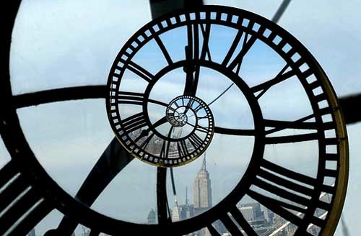

Slide 16
Time is “as like as possible to eternity”
How would you define eternity?
Could time be more like eternity?

Slide 17
“We use such expressions as what is past is past, what is present is present, what is future is future, and what is not is not, none of which is strictly accurate.”
This passage follows a discussion of the idea that measurable cycles imitate eternity.
How does this relate to
Aristotle’s vision of time?

Slide 18
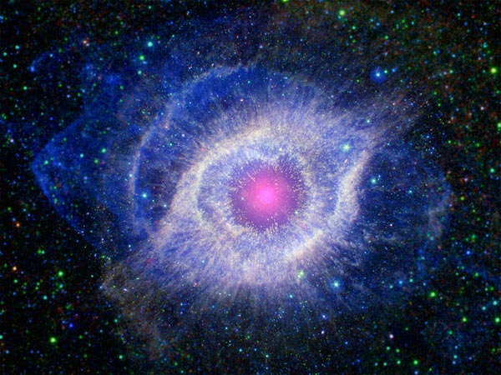
Abstract or Tangible?
“Time came into being with the heavens in order that having come into being together, they should also be dissolved together if ever they are dissolved.”
(If “the heavens” is our universe…) Is time concretely tied to the existence of substance OR an abstract idea that can exist in a void?

Slide 19
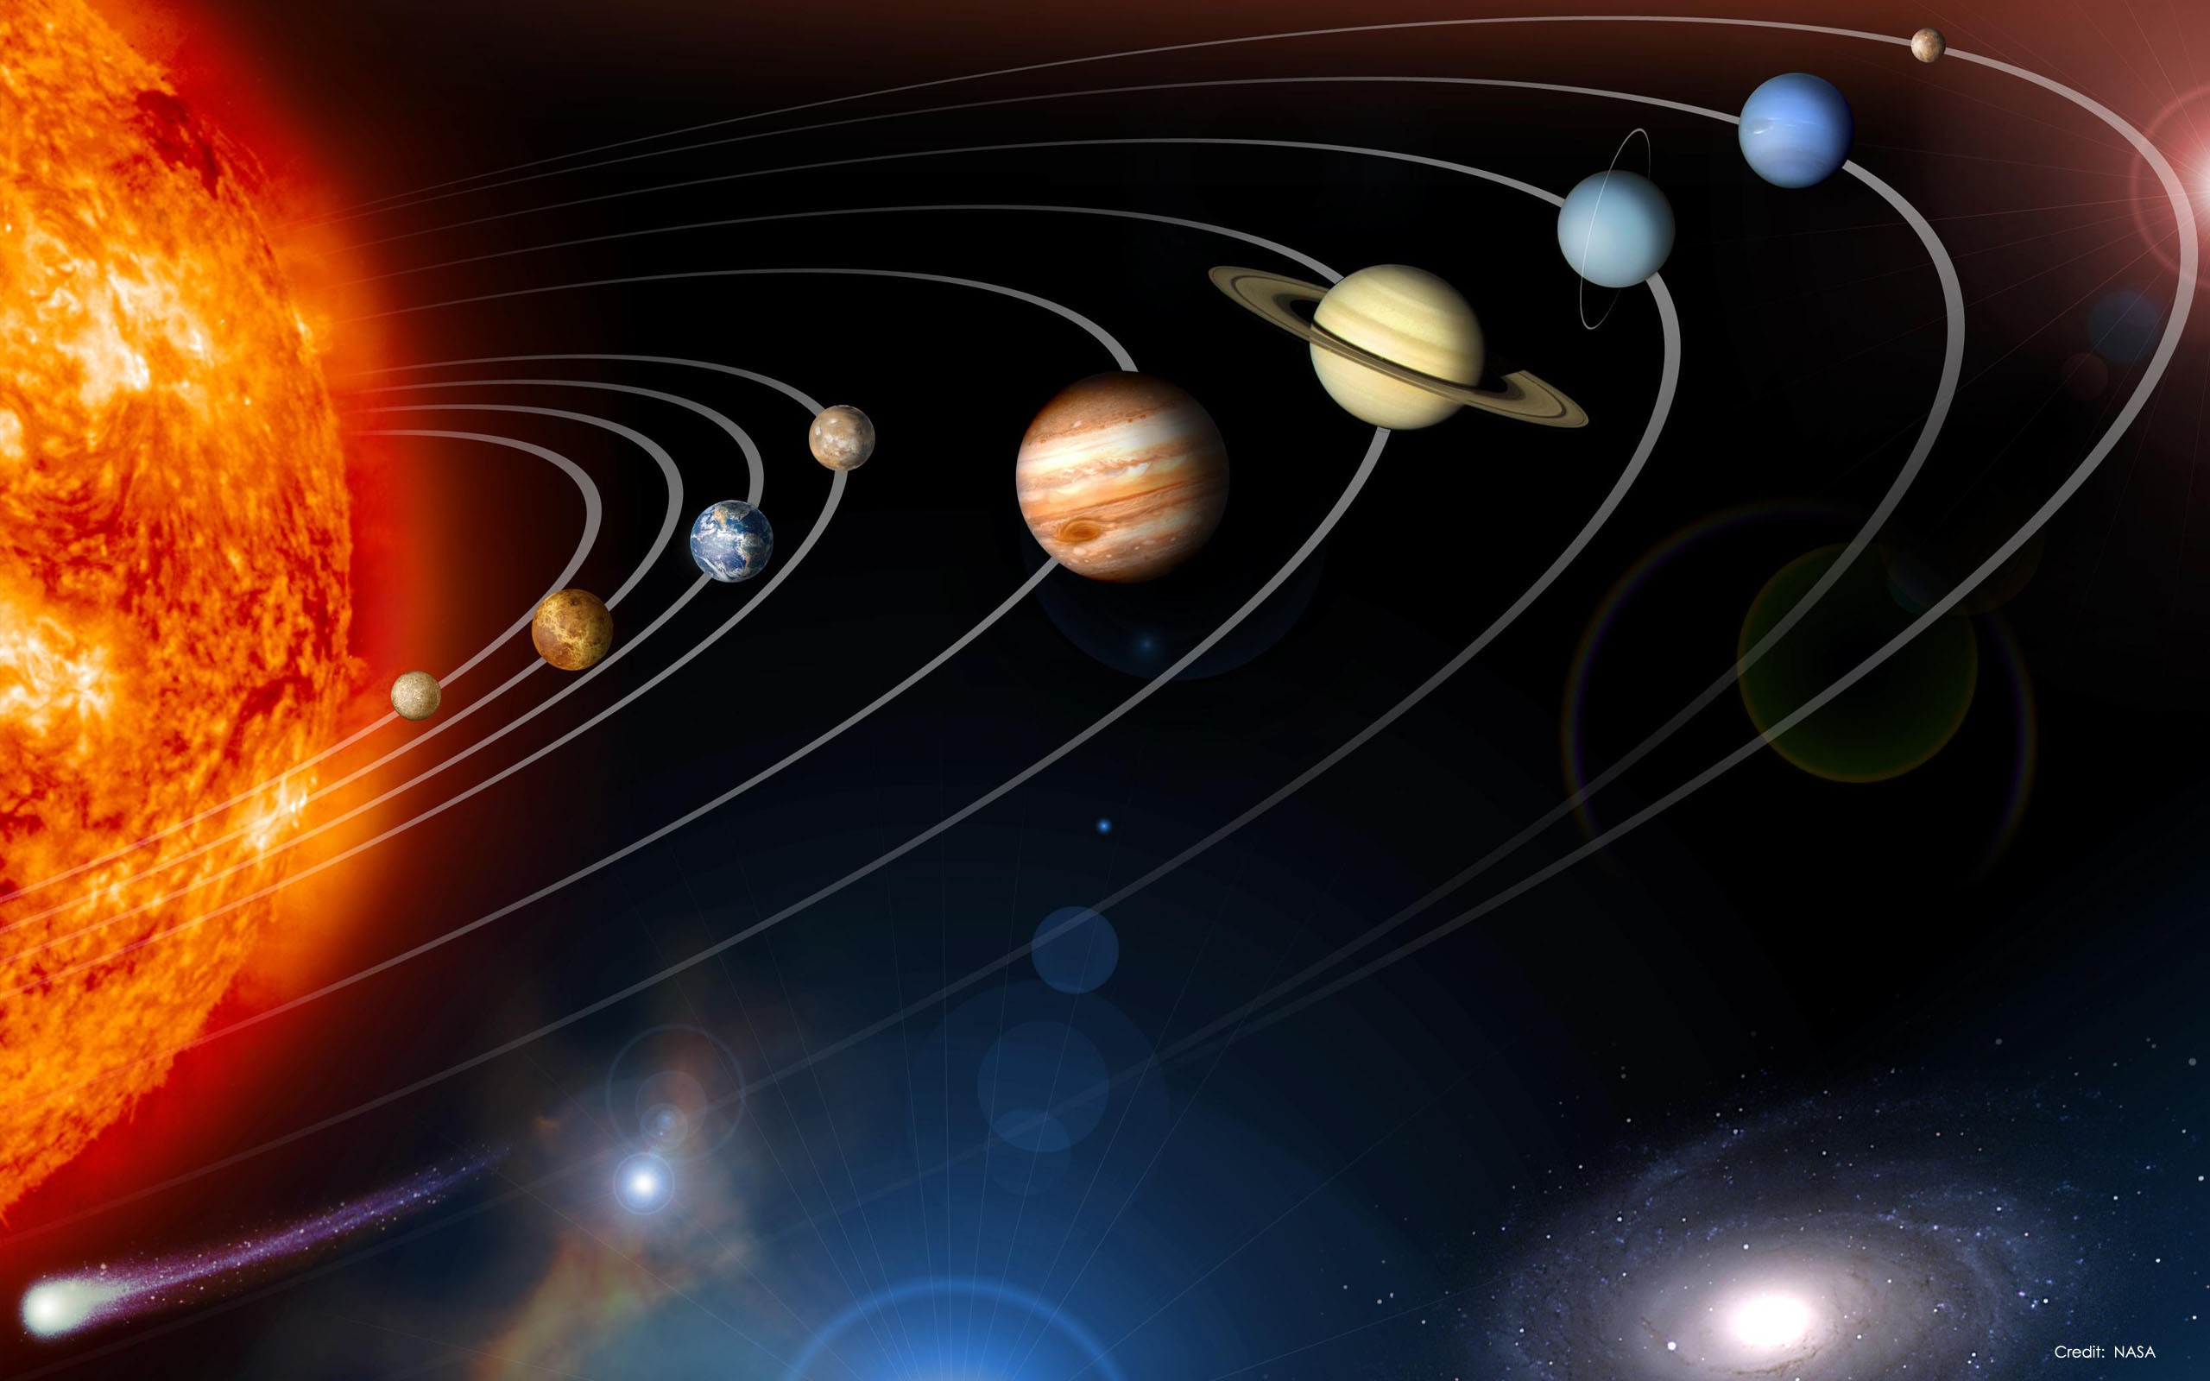
“For because their [the planets] movements are a combination of two distinct contrary motions, it gave them a spiral twist and made the body which falls behind it most slowly (its own motion being the most rapid of all) seem to keep pace with it most closely.”
What is the spiral twist? How does it relate to spatial visualizations of time?

Slide 20
The light of the sun enables “the appropriate living creatures to gain a knowledge of number from the uniform movements of the Same.”
Appropriate? Relation to the privilege of time keeping & calendric knowledge in Minoan/Greek Society? Concepts of time in other species?

Slide 21
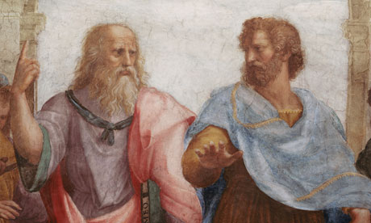
Aristotle on Time: Book IV of Physics
(384 BC – 322 BC)

Slide 22
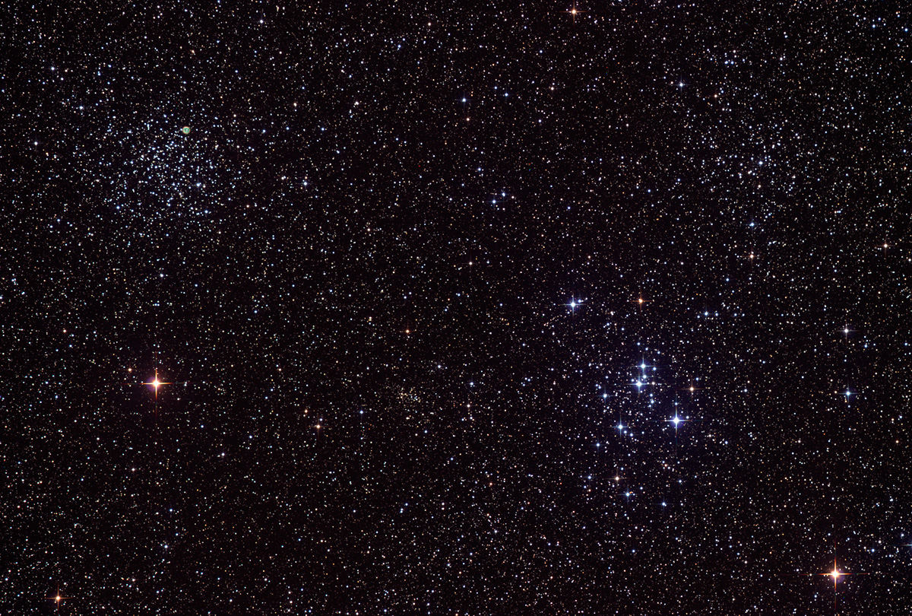
Plato v. Aristotle
Plato: “eternal moving image of the eternity which remains at one”
Eternity is a mode of existence unconditioned by time
Does not distinguish between past, present, and future
Aristotle: “…time is number of movement in respect of the before and after…”
Expresses a notion of everlasting existence

Slide 23
Aristotle’s Questions
“…time is number of movement in respect of the before and after…” (220a24-220a26)
What does this mean?
Concept: time is the coming-to-be and passing-away of ‘nows’ —do these exist?
Does time exist ?
A part is a measure of the whole, which is made of parts
Paradox

Slide 24
Time, Motion and Change
Time is not motion or change but closely related to them
Why is time dependent on these two concepts?
Why is time not motion?
Time as non-motion is impossible
The changing speed of motion
“It is only when we have perceived before and after in motion that we say time has elapsed” (219a22-219a29)
Important implications: sleep example

Slide 25
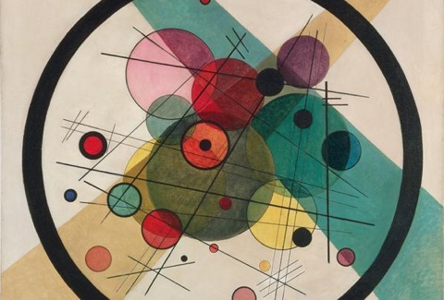
Time and Change
Time is the number of change — changes remove what is
Can things last forever?
How is time portrayed as an agent of change?

Slide 26
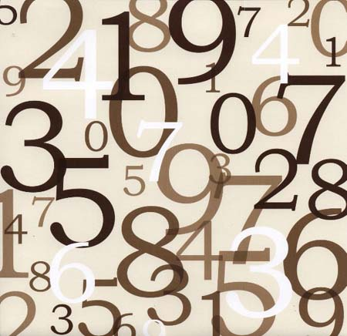
Time as a number
New definition: “Time is just this — a number of motion in respect of ‘before’ and ‘after.’ (219b1)
Example of seven horses and seven dogs
Implications?
Problems with this statement?
Second Paradox

Slide 27
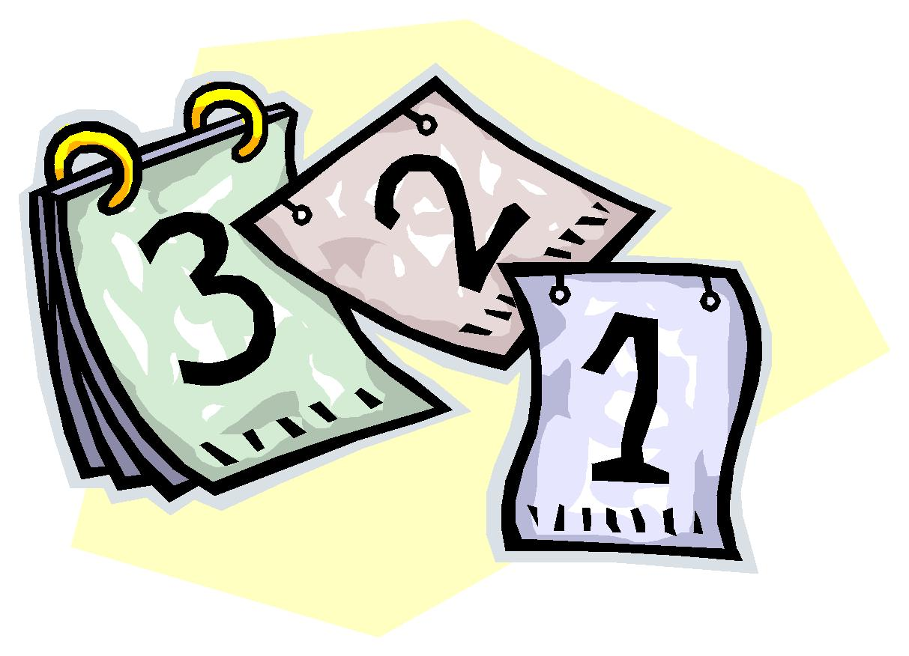
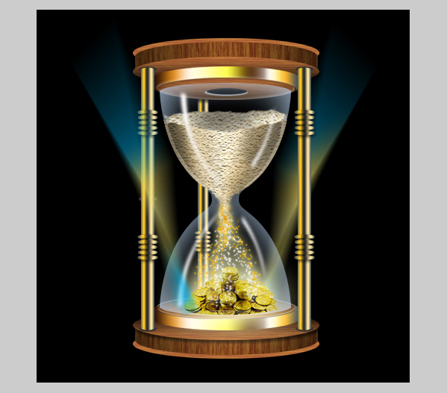
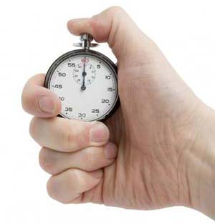
Time and Change
How do you measure time?

Slide 28
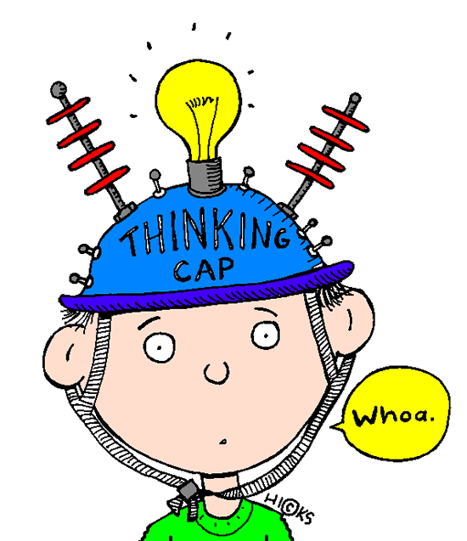
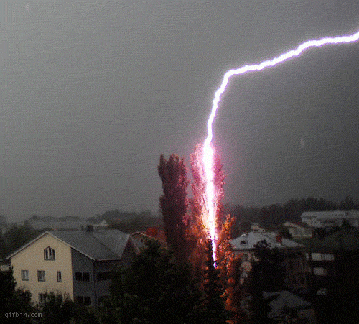
Time and Change
Aristotle’s View

Slide 29
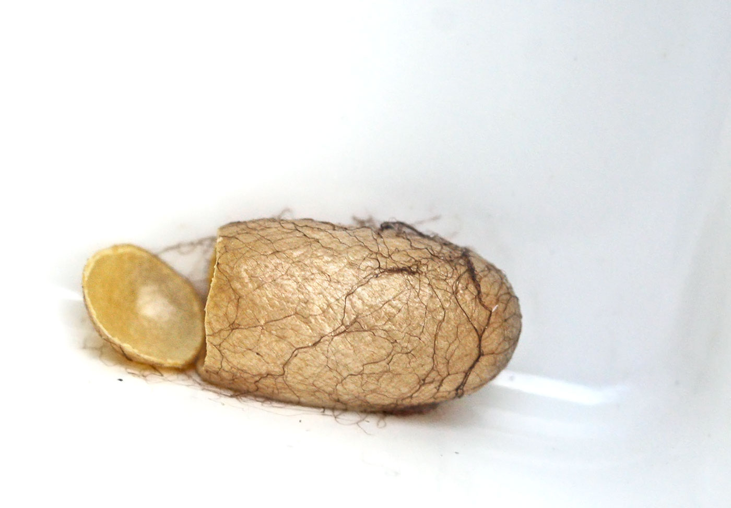
Change and Growth
Potential

Slide 30
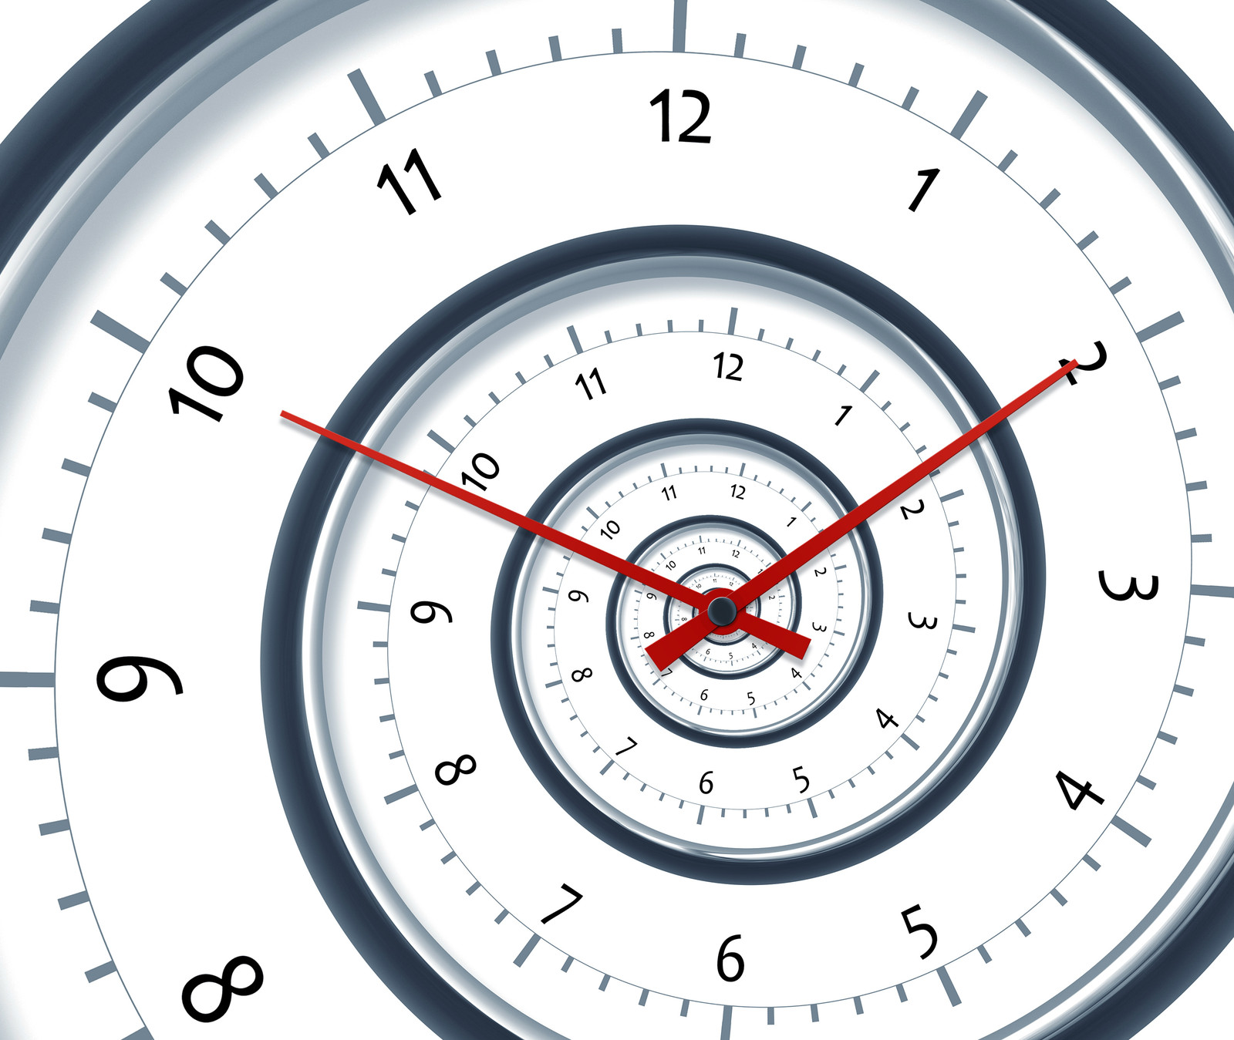
Takeaways
What’s the nature of time?
Does it even exist?

Slide 31
And Most Importantly
Happy Birthday to Edward Reed

